Slide 1
The Role of the Media

Slide 2
Lets Look at the Media
Wall Street Journal https://www.wsj.com/
Conservative Paper National Review http://www.nationalreview.com/
Conservative News Network Fox News http://www.foxnews.com/
New York Times https://www.nytimes.com/
Liberal News Network CNN http://www.cnn.com/

Slide 3
Understand the importance of Media in the protection of democracy

Slide 4
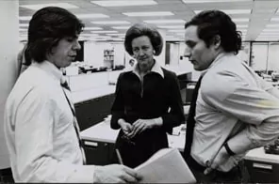
Scandals
Washington post

Slide 5
Media Bias

