Slide 1
What are Eating Disorders?
It is not a phase, rather a real condition that greatly impacts a person’s physical, emotional, and social health.
20 million women
10 million men
suffer from eating disorders
Real,complex, devastating conditions that can have serious consequences on a person's health.

Slide 2
60% of elementary school girls (6-12 years) are concerned about their weight or becoming “fat”.
3 common types of Eating Disorders
Anorexia nervosa
Bulimia nervosa
Binge-eating disorder
#1 cause of an eating disorder is dissatisfaction of one’s body.

Slide 3
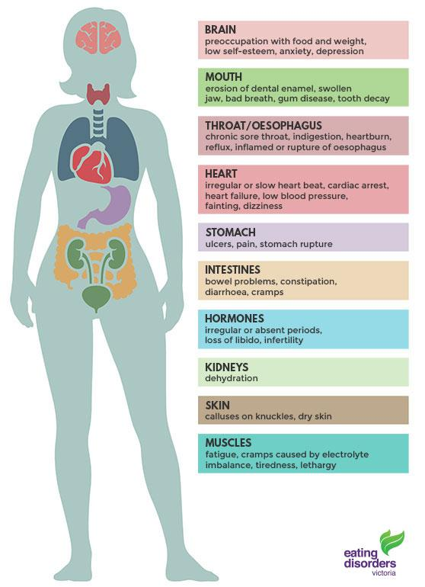
Physical Signs and Effects of
Bulimia

Slide 4
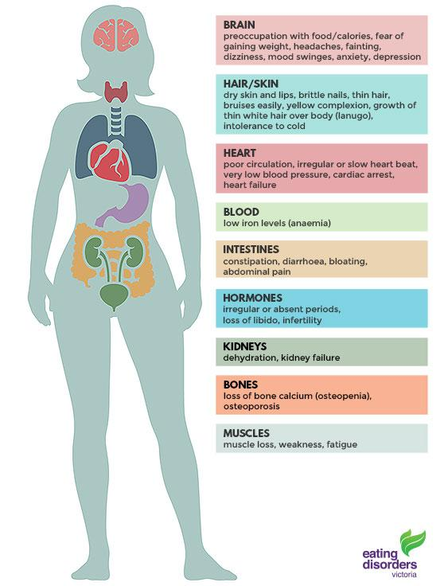
Physical signs and effects of
Anorexia

Slide 5
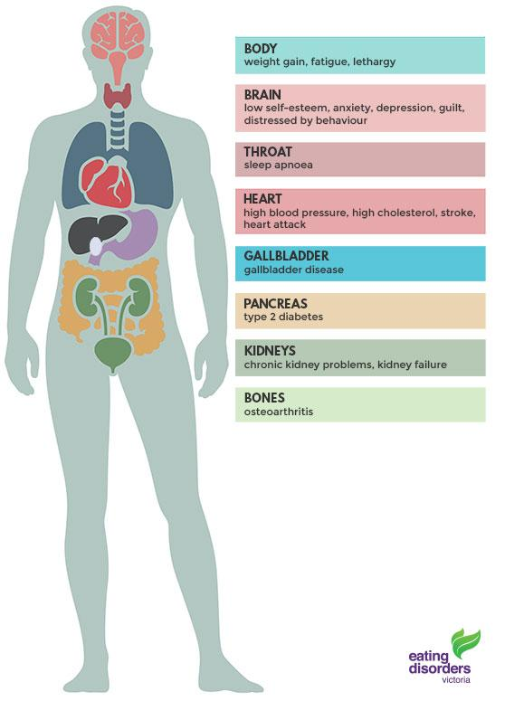
Physical signs and effects of
Binge-Eating Disorder

Slide 6
Eating Disorders “Do Now”
Explain the difference between anorexia and bulimia.
What is the number one cause of an eating disorder?
Who is impacted more by eating disorders? Men or Women?
Hotline: 1-800-931-2237

Slide 7
EDNOS (Eating Disorders Not Otherwise Specified)
Medical research reveals there are many different ways people may have disordered eating that causes them severe health risks.
Sub-Diagnoses that applies to all patients who may not fit the exact criteria for bulimia or anorexia but still have very troubled relationships with food and body image.
Orthorexia
Fixation with healthy or righteous eating
Pregorexia
Extreme dieting during pregnancy to avoid gaining the 25 to 35 recommended pounds by the doctor.
Drunkorexia
Restricting food intake in order to reserve those calorie for alcohol. Not eating to feel the effects of alcohol more.

Slide 8
Fad Diets role with Eating Disorders
It's easy to flock to diets that promise fast results with little effort. Fad diets backfire, because you’ll likely regain any pounds you shed.
Promise fast, immediate weight loss
Aim weight loss from specific parts of body
Dangerous, unhealthy, lacks vital nutrients
Triggers obsessions with weight loss
Lead to drastic changes in diet and food choices

Slide 9
Fad Diets
Eating Disorders
Weight Weight
Gain Loss
Vicious Cycle of Dieting

Slide 10
Eating Disorders statistics “Do Now”
Males represent 25% of cases
2. 60% of cases are female
3. Rates have remained the same since the 1990s.
4. Mortality rate of 10%
5. 31% have a history of alcohol abuse.
6. 25% also struggle with substance abuse
Bulimia
Binge Eating Disorder
Anorexia

Slide 11
Eating Disorders statistics “Do Now” Answers
Males represent 25% of cases Anorexia
2. 60% of cases are female Binge Eating Disorder
3. Rates have remained the same since the 1990s. Bulimia
4. Mortality rate of 10% Anorexia
5. 31% have a history of alcohol abuse. Bulimia
6. 25% also struggle with substance abuse Binge Eating Disorder

Slide 12
Risks of Eating Disorders!
Those who suffer need serious professional help for the body physical but also their minds mentally.
Irreversible damage can occur and people can die!
Binge-eating
-Unhealthy weight gain resulting in heart disease, diabetes, stroke.
Anorexia
-Cessation of menstruation
-Loss of bone density
-Reduction in organ size
Bulimia
-Dehydration, kidney damage
-Irregular heartbeat
- Nutrient deficiencies

Slide 13
https://www.youtube.com/watch?v=vCTXV15mKQ4
Demi Lovato sits down with Katie Couric to discuss her personal struggles with eating disorders, body image, self acceptance and how bullying played a role in her poor self-esteem. How you can overcome the disorders and learn to love yourself for who you are.

Slide 14
When did Demi’s body issues start? Explain what she said.
Katie Couric admitted to struggling with an eating disorder, at what point in her life did this occur?
What three conditions was Demi struggling with?
How much does bullying contribute? Explain.
Demi explains her experiences with eating disorders, where does she believe it all started for her?
At her worst, how many times a day was Demi purging/vomiting?
How did social media play a role in Demi’s life?
Why does Demi & her counselor call eating disorders a family disease?

Slide 15
“Disordered Eating Do Now”
What does EDNOS stand for?
What is the name for the eating disorder when a women diets extremely during pregnancy?
Another title for eating disorders is….
Explain weight cycling?
________ million men suffer from eating disorders.

