Slide 1
Can you beat the people on the Street
What happened on JULY 4^{th?}
Who did we get our independence from?
Who sewed the first American Flag?
What did Paul Revere say when the British were coming?
Which General led our troops in the war for independence?
Who were the minute men?
Why did Washington cross the Delaware.
When was the Revolutionary War
How many original colonies were there?
http://www.dailymotion.com/video/xf0a2u

Slide 2
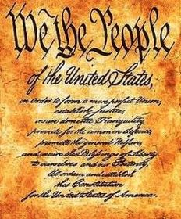
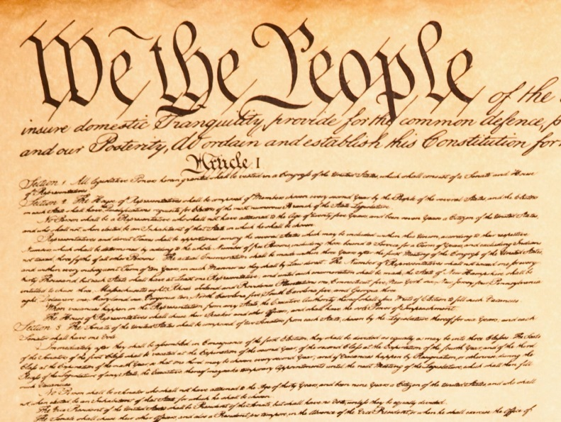
Anatomy of The Constitution
What is the difference between the Declaration of Independence and the US Constitution?
What is the purpose of the Constitution?
What is so special about our constitution?

Slide 3
Anatomy of The Constitution
What is so special about our constitution?

Slide 4
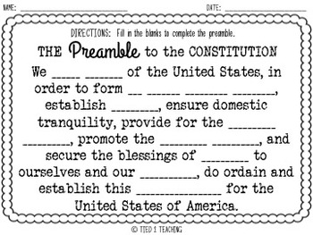
Preamble
Can you fill in the blanks?
Introduction to the ideals of the constitution?
Why is the beginning so radical?

Slide 5
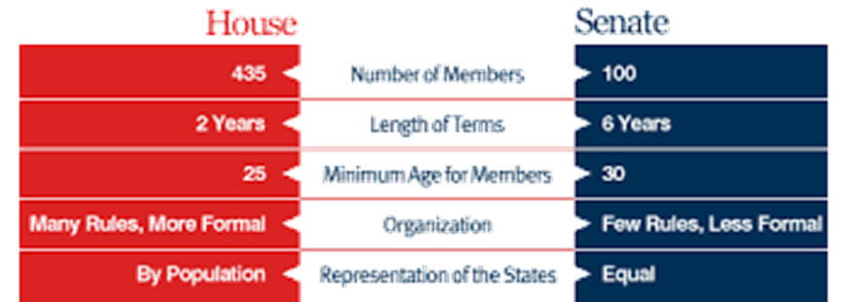
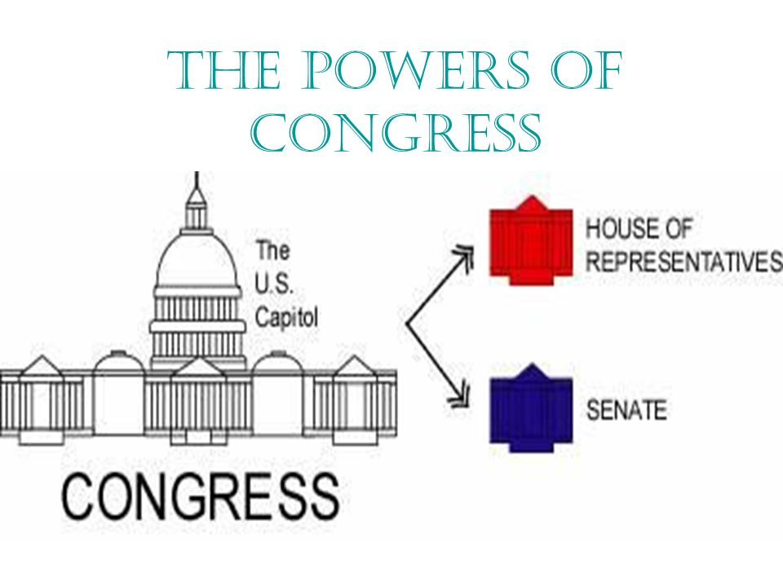
Article 1
Outlines the purpose and responsibilities of the legislative branch known as Congress is essential in a representative democracy or…..
Republic
Congress is bi-cameral meaning its divided into two houses also called chambers
Senate
House of representatives

Slide 6
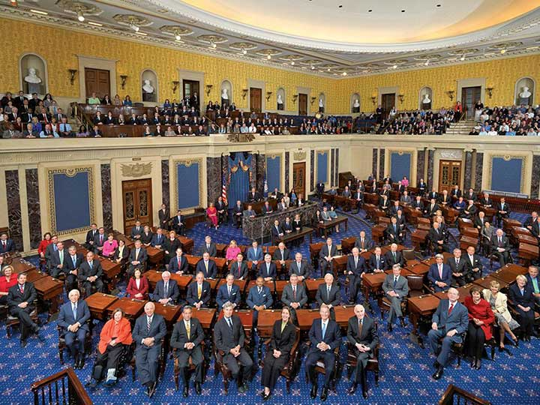
Article 1 - Congress
Senate – Most powerful
Equal representation for each state
6 years
30 years old and a citizen for 9 years
Senators can
Confirm Appointments
Ratify Treaties
Remove a president from office

Slide 7
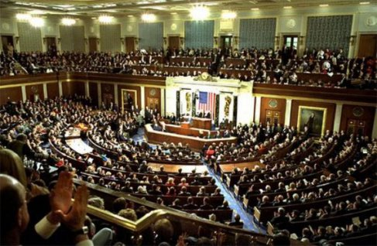
Article 1 - Congress
House of Representatives – peoples house
Based on population - 435
2 years
25 years old and a citizen for 7 years
Most bills originate in the House
House decides to impeach (indictment)

Slide 8
Congressional Responsibilities
Collect Taxes
Borrow Money
Regulate Trade
Make Money
Create A Post Office
Patents
Create courts
Punish Pirates
Declare war…sort of
Laws that are necessary and proper

Slide 9
Article II
The President- Chief Executive – executes the laws – carries them out
Elected for a term of years
Must be 35 years old
A natural born citizen of the US
And a resident for 14 years.
Duties
Commander and chief
Maintains a cabinet to execute the demands of the office
Vice president and 15 executive departments
Negotiate treaties
Represents the US to foreign countries
Grants pardons/clemency
Executive orders

Slide 10
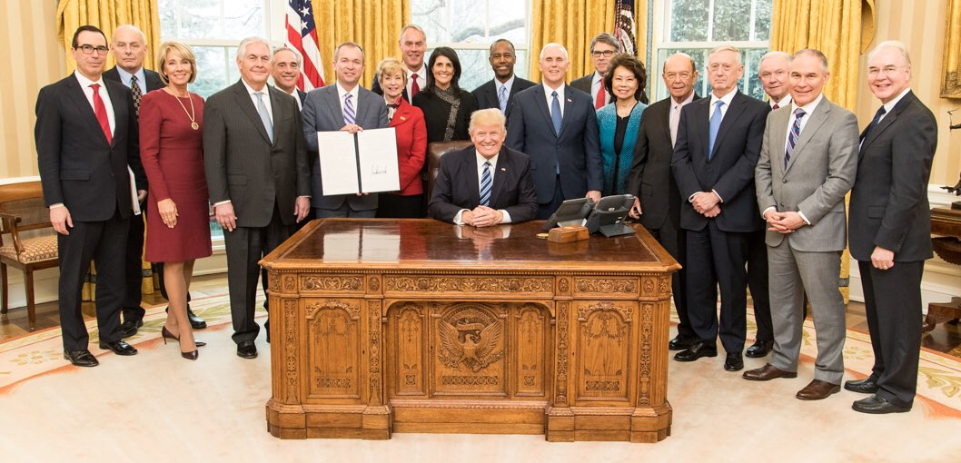
President’s cabinet

Slide 11
Presidential Cabinet
Vice President Michael R. Pence
Secretary of State Rex W. Tillerson
Secretary of the Treasury Steven T. Mnuchin
Secretary of Defense James Mattis
Attorney General Jeff Sessions
Secretary of the Interior Ryan Zinke
Secretary of Agriculture Sonny Perdue
Secretary of Commerce Wilbur L. Ross, Jr.
Secretary of Labor Alexander Acosta
Secretary of Housing and Urban Development Benjamin S. Carson, Sr.
Secretary of Transportation Elaine L. Chao
Secretary of Energy James Richard Perry
Secretary of Education Elisabeth Prince DeVos
Secretary of Veterans Affairs David J. Shulkin
Acting Secretary of Homeland Security Elaine Duke
Acting Secretary of Health and Human Services Don J. Wright
Congress members (Representatives and Senators): $174,000.
Senate and House Majority/Minority Leaders: $193,400.
Cabinet members: $199,700.
Speaker of the House: $223,500

Slide 12
Presidential Cabinet
White House Chief of Staff
U.S. Trade Representative
Director of National Intelligence
Representative of the United States to the United Nations
Director of the Office of Management and Budget
Director of the Central Intelligence Agency
Administrator of the Environmental Protection Agency
Administrator of the Small Business Administration

Slide 13
Examples of Executive Orders
Equal Employment Opportunity
bars discrimination in federal employment because of race, color, religion, sex, or national origin. [1]
Affirmative Action
All applicants are employed, and employees are treated during employment, without regard to their race, creed, color, or national origin." [2]
Works Progress Administration
put more than 8.5 million Americans back to work rebuilding the country one bridge, road, and mural at a time. [3]
Desegregation of Schools
The Emancipation Proclamation.
Desegregation of The Military Service

Slide 14
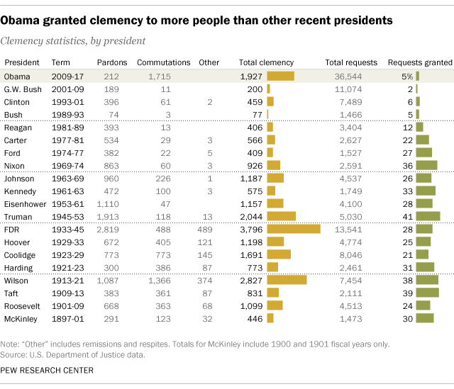
Grant Pardons

Slide 15
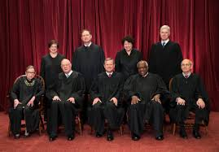
Article III
The Supreme Court
No age requirement or citizenship
Serve for….
Why
Appointed by the president
Approved by congress
Also explains trial by jury and treason
Treason against the United States, shall consist only in levying war against them, or in adhering to their enemies, giving them aid and comfort. No person shall be convicted of treason unless on the testimony of two witnesses to the same overt act, or on confession in open court.

Slide 16
Article IV
Regulates states rights and interaction of states with one another.
Extradition
Discusses how New States can be admitted into the Union.

Slide 17
Article V
How to alter/amend the Constitution

Slide 18
Article VI
Federalism
Everyone must take an oath to uphold the US Constitution.

Slide 19
Article VIII
State | Date | Votes for | Votes against
Delaware | December 7, 1787 | 30 | 0
Pennsylvania | December 12, 1787 | 46 | 23
New Jersey | December 18, 1787 | 38 | 0
Georgia | January 2, 1788 | 26 | 0
Connecticut | January 9, 1788 | 128 | 40
Massachusetts | February 6, 1788 | 187 | 168
Maryland | April 28, 1788 | 63 | 11
South Carolina | May 23, 1788 | 149 | 73
New Hampshire | June 21, 1788 | 57 | 47
Virginia | June 25, 1788 | 89 | 79
New York | July 26, 1788 | 30 | 27
North Carolina | November 21, 1789 | 194 | 77
Rhode Island | May 29, 1790 | 34 | 32
Ratification
9/13 states had to accept the constitution as law
Nervous to ratify without the human rights outlined or expressed in the document
1791 the Bill of rights was added 2 years after the ratification of the US Constitution.

Slide 20
Article V
How do you alter the constitution…
Amend it…
How
Propose it and then you ratify it.

Slide 21
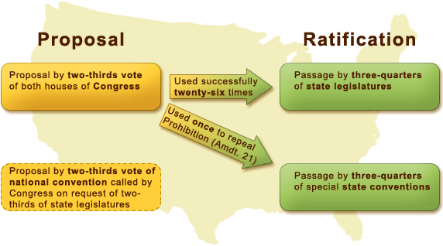
Article V
38

Slide 22
Out of 33 approved amendments only 27 have ever been ratified.

Slide 23
Quiz Review
How many senators
How many members of the house
How many articles are in the constitution
Which article describes the length of a presidents term
How long do you serve if you are a
Senator
President
Member of the House of Representatives
Supreme Court Justice

Slide 24
Quiz Review
How many states must ratify an Amendment?
The president has two powers with very little check on them …what are they?
What does extradite mean?
How do you become a Supreme Courte Justice?
The constitution gives which branch of the government the most power?

Slide 25
Review
Name three powers of the president
Name 3 congressional powers.
What title is given to collection of presidential advisors who oversee his departments?
Why are do Supreme Court Justices serve the terms they do?
What are the first 10 changes to the constitution called?

