Slide 1
Drugs (Illicit substances)
World Drug Report 2019: 35 million people worldwide suffer from drug use disorders while only 1 in 7 people receive treatment

Slide 2
Chemicals produced by cells in your brain
Serotonin
- Considered a “mood stabilizer”
- reduces depression
- regulates anxiety
- regulates happiness
- controls your sleep/wake cycle
Dopamine
- Considered the “feel good hormone”
-creates pleasure through reward and motivation (learning, goal setting, accomplishments)
- boosts focus and energy
-creates pleasure and euphoria

Slide 3
Serotonin & Dopamine
- When a person takes drug, the substance will greatly increase the amount of serotonin and/or dopamine the brain is producing and absorbing, creating a “high”.
-The term “high” comes from the brain reaching levels it cannot ever reach on its on naturally.
-The more a person puts a drug(s) into their body the more the brain adapts to these “highs”. The brain becomes more dependent on the drug(s) to feel good and produce serotonin and and dopamine that over time the brain will stop producing these chemicals on its on and become solely dependent on the drug(s) to do it.
-Without the drug(s) a person no longer can feel “good”, sleep/wake cycle is disrupted, they feel more depressed/anxious, they are not motivated and parts of their brain become inactive.

Slide 4
Drug Overdoses Kill more people than Breast Cancer
- THC (active ingredient in marijuana that causes addiction) is nearly 5 times stronger today in marijuana than it was just 15 years ago!
-Teens that discuss the dangers of drug use with family are 50% less likely to ever start using.
- 13 years old is the average age in the US for children who experiment with trying drugs.

Slide 5
Drug Terms (Blue Textbook, Pages 592-595)
Substance Abuse
Illegal Drugs
Illicit Drug Use
Overdose
Psychological Dependence
Physiological Dependence
Addiction

Slide 6
Gateway Drugs-A substance that may lead a user to try other more addictive substances.
*Tobacco/Vaping
*Alcohol
*Marijuana
Factors that influence a person’s decision to use drugs
peer pressure, family’s use, media’s perception, music influence, stress
#1 influence on teens: Peer Pressure

Slide 7
Effects of Drugs on the body
Depressants
Slow down (depress) the central nervous system. Which is slowing breathing rate, heart rate and blood pressure. Motor functioning is slowed/delayed. Increased risk for coma and heart attack.
Stimulants
Stimulate the central nervous system. Which will increase heart rate, blood pressure, and breathing rate. Greatly increasing risk for heart attack.

Slide 8
Categories of Drugs
Stimulants include: cocaine, crack, methamphetamine, LSD, PCP
Depressants include: heroin, alcohol, marijuana, opiates, inhalants
Opiates- Highly addictive, some legal by prescription to help block severe and chronic pain (vicodin, percocet, morphines)
Hallucinogens- Very powerful substances that greatly impact sensory perception (sight, smell, sound, taste, touch) and emotions/thoughts. These are substances like LSD, PCP, ecstasy, MDMA and Mushrooms.

Slide 9
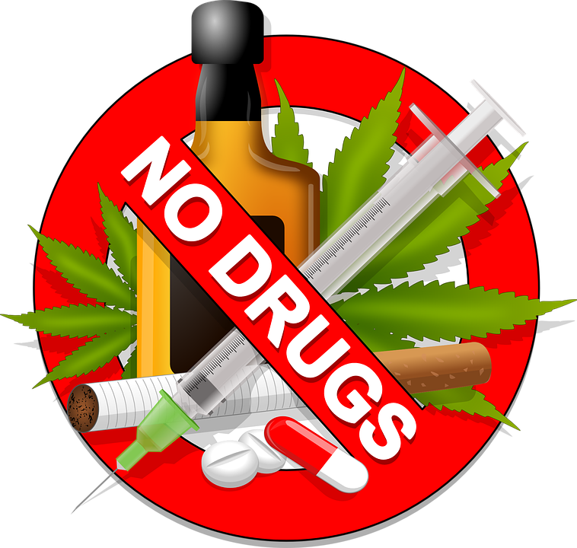
Categories of Drugs
Designer Drugs-These are man made substances not that are not naturally found. Ecstasy, MDMA (molly) PCP, LSD
Synthetic- Means fake or man made.

Slide 10
Types of Treatment Programs
Long-Term Residential Treatment- 24 hour a day care, very structured. Typically 6 to 12 month residency.
Short-Term Residential Treatment- 21 to 45 day hospital based facility. Usually followed up with counseling and other programs.
Outpatient Treatment- Intensive day programs with education, counseling, and other therapies.
Individual & Group Counseling- Varies by need of the person and the amount of sessions required/mandated.

Slide 11
Enabling
When a person thinks they are helping the addict, but they are actually contributing to the addict’s use and self-destructive indirectly.
*May be hard to see, but an enabler is actually making it possible for the person to continue abusing drugs or alcohol.
* An enabler may allow the substance abusing person to live and use in their home. They may lend them their car or give them rides. They may give them money or pay their bills.

Slide 12
Don’t be an Enabler….
Don’t be naive and don’t ignore what is really going on.
Don’t make excuses for the person using/abusing.
Reject their lies and manipulation.
Investigate odd behavior and protect your valuables.
Show them you LOVE and want to HELP them but you will not stand by any longer to watch them destroy their health and life.
Be strict, but SUPPORTIVE of their sobriety.

Slide 13
Heroin use is majorly on the rise...
With increasing cost of prescription drugs and limited access to getting them, more and more opiate dependent addict’s are resorting to using Heroin, which is a cheaper, more powerful opiate drug.
Heroin is extremely addictive! Many users are fully addicted and dependent on heroin after only one use!
Narcan (naloxone)- A medication that can save lives by reversing the effect of overdoses caused by heroin & other opiates like prescription drugs; hydrocodone & oxycodone. Narcan is administered nasally due to a person being unresponsive by overdose.

Slide 14
The rise of HEROIN use and OVERDOSE
According to the CDC, someone dies every 19 minutes from a drug overdose.
3 out of 4 of the drug overdoses are caused by opiates.
Drugs are being mixed with other more dangerous substances more today than ever before causing easier overdoses, high potencies, more addictive products and less effective treatments and medications.
Dealers are lacing (cutting or mixing) to increase their product and create new addictions.
Fentanyl is 50 times stronger than heroin & is being discovered more & more daily mixed with heroin and the user’s are unaware! Narcan cannot stop the overdose of fentanyl.

Slide 15
Avoiding Drug Use
Millions of teens avoid drug use everyday! It is important to remain discipline to your morals and values, and not feel pressured by friends or society to do something you are not choosing to do on your own.
Remember, it is YOUR CHOICE and if you put these substances or others in your body then you should be well aware of the harm, dangers and risks to your health and life.
Surround yourself with friends who respect YOUR choices, that like you for who you are and support what you want for yourself in the future.
It’s YOUR life, don’t live it trying to impress others. Be a LEADER.

