Slide 1
Agenda
Define federalism and its working parts
Go over the issues that exist between the states and the federal government.
https://www.youtube.com/watch?v=9yu7qI9XVRU

Slide 2
How much power should the federal government have.
How much power should the federal government have?
When should the federal government have power?
When should states be left to themselves?
When shouldn’t states be left to their own devices?

Slide 3
Federalism a History
We were colonies
There was a war…..
We were no longer colonies but we also couldn’t be completely independent states or nations …why
Needed to be able to go to war and trade with each other
We tried to unify…but we were WEAK! What was our first attempt at a constitution called?
Articles of Confederation
Created a strong centralized government with powers outlined in the constitution.

Slide 4
Federalism - Powers
Three types of powers outlined in the constitution
Express – powers held by the federal government
Reserved – powers given or reserved by the states
Finally shared powers called….
Concurrent powers….like
Road constructions or tax collection

Slide 5
Review
The term for when states or provinces share power with a central government
A power given to the federal government
A power shared by the federal government and the state government
A power given to the states
The federal government has two kinds of power …what are they?
What gives the federal government authority over the states ability to make laws

Slide 6
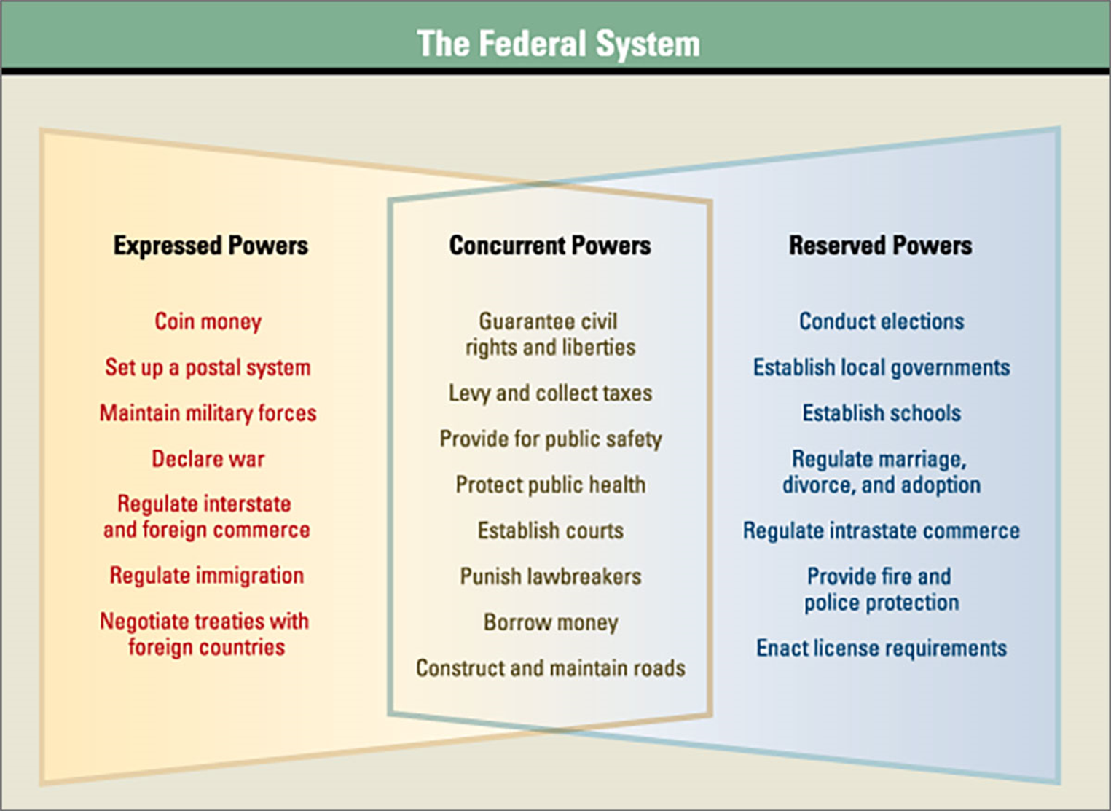
Federalism - Powers
Three types of powers outlined in the constitution

Slide 7
Federalism General and a regional government
…
The Supremacy Clause sates that the 50 states can’t make laws that go against the U.S. Constitution
They have a higher or (Supreme) authority above them!

Slide 8
Federalism
Federal Government has two types of powers
Express
powers that are specifically outlined in the constitution
Ex – make money or impeach a president
Implied
Not expressly stated but implied through the Necessary and Proper clause
Ex the creation of a federal reserve or bank for the use of collecting taxes.
Expressed power is to “maintain the military”
Implied power is the creation of the Draft

Slide 9
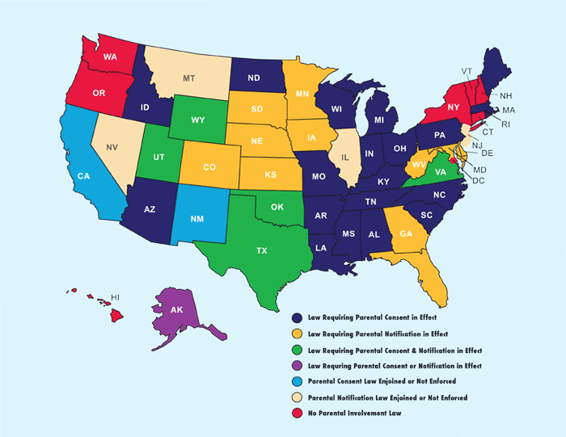
Federalism in Action
Abortion in the United States is legal,
via the landmark case of Roe v. Wade. ...
individual states can
regulate/limit the use of abortion
create "triggerlaws"

Slide 10
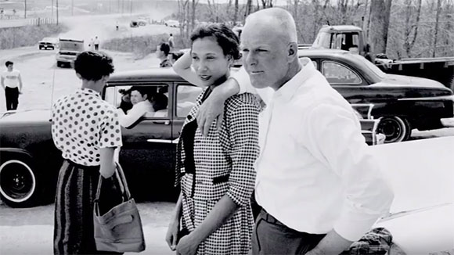
When should the federal government have rights over the states?
Loving vs. Virginia
Mildred and Richard Loving
Violated due process and equal protection

Slide 11
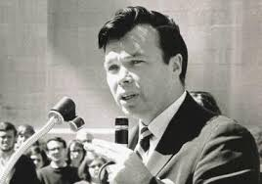
Einstadt vs Baird
William Baird - 1972

Slide 12
https://www.nytimes.com/interactive/2017/10/10/us/california-fires-maps-photos.html

Slide 13
Federalism a History
We were colonies
There was a war…..
We were no longer colonies but we also couldn’t be completely independent states or nations …why
Needed to be able to go to war and trade with each other
We tried to unify…but we were WEAK! What was our first attempt at a constitution called?
Articles of Confederation
Created a strong centralized government with powers outlined in the constitution.

Slide 14
Response Group
Get into groups of three
Your group will examine three case studies in which either the national government or a state government faced conflict in exercising its powers.
After examining the facts and arguments, your group will determine whether, according to the U.S. federal system, a legitimate use of power exists
https://subscriptions.teachtci.com/shared/programs/163/lessons/1434/slide_shows

Slide 15
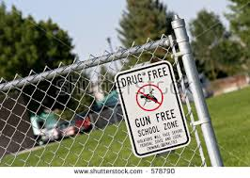
Response Group
What do you see in this image
What federalism issue do you think this photograph
Do you think the national government or the state governments should have the power to control guns near schools?
Read Student Handout A: Federalism and Gun Control Laws.

Slide 16
Then, discuss the questions at the bottom of the handout with your group. You must come to an agreement on Question 3 and be ready to share your response with the class.
Use this diagram of the federal system to help answer the questions:
Appoint a Presenter for your group

Slide 17
Response Group
When called on by the teacher, Presenters share your group’s response to Question 3:
Appoint a Presenter for your group.
Do you think the national government has the power to prohibit the possession of firearms near schools? Why or why not?

