Slide 1
Barriers to Voting

Slide 2
Why we don’t vote
My Vote Doesn’t count
I Don’t feel educated enough
Many are kept out
Don’t know how to register or vote
http://www.elections.ny.gov/votingregister.html

Slide 3
Why do we vote?
First time voters - https://wethevoters.com/film/first-time-voters
So you think you can vote. http://pbseduelectioncentral.com/we-the-voters.html

Slide 4
Should People Be Allowed to Vote Early

Slide 5
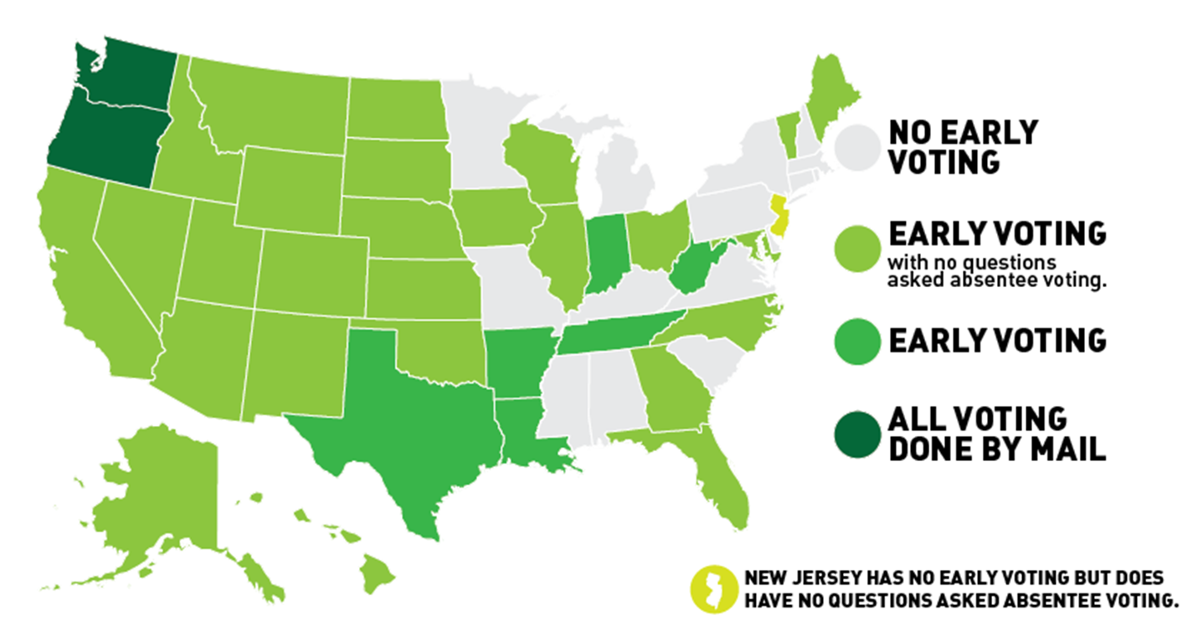
Early Voting

Slide 6
Should people be allowed to use an absentee ballot without showing a just reason?

Slide 7
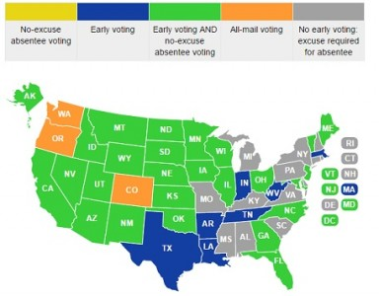
Absentee Voting

Slide 8
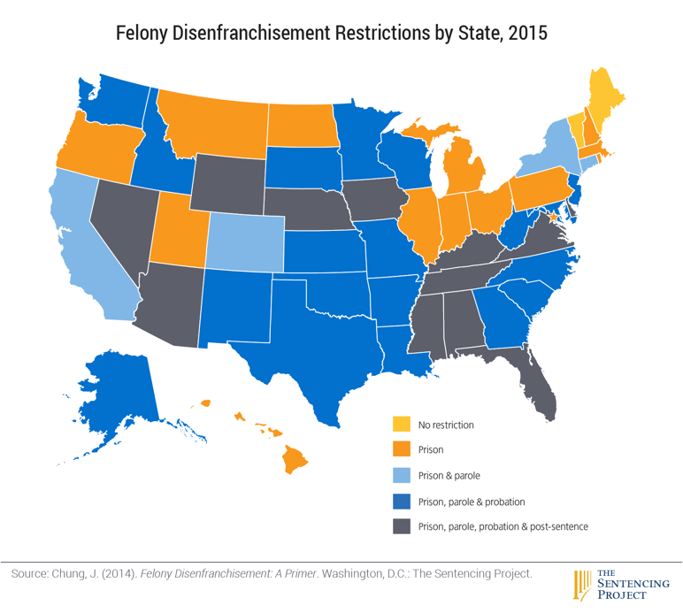
Ex Felon Voting

Slide 9
Should you have to use ID to vote?

Slide 10
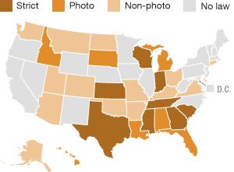
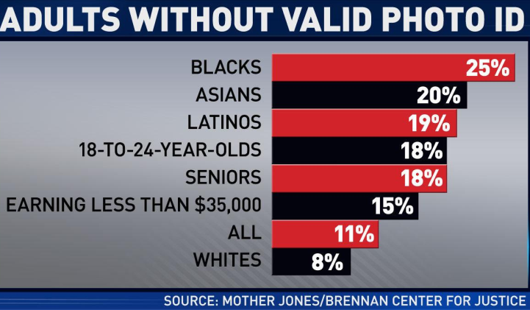
Voter ID Laws

Slide 11
The Cost of Voting
1-3 Number of hours that employers are required by law to give workers off in order to vote in the major
$0 Cost of public transportation on Election Day in areas like Houston, Dallas and Portland ME
$0 The cost of renting a Zipcar from 6 p.m. to 10 p.m
$0 Cost of childcare provided by select participating YMCA locations
350,000 vs. 21,000 Total number of extra miles that must be traveled by African Americans and whites, respectively, for North Carolina residents to get to their nearest voting station
200 Number of miles some Native American tribes must travel round trip in order to vote on Election Day
$544 Million Estimate for how much was lost in terms of productivity strictly due to people waiting in line
11 Number of states that give general Election Days as paid holidays for state employees vote in 2012

Slide 12
How much does your vote cost?

Slide 13
The Cost of Voting
75 to $400 The range of per-person costs associated with voter ID laws
$2,500 to $100,000 cost for new voting machines.
$3 Billion How much it would cost to replace all of the voting machines
$3 Million How much Oregon has saved each election cycle since 2000, when the state shifted to a system in which all voting is conducted by mail.
$10 amount your vote costs in each municipality

Slide 14
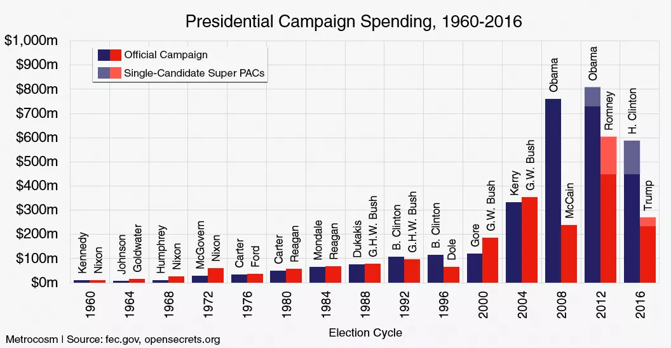

Slide 15
What are they spending money on

Slide 16
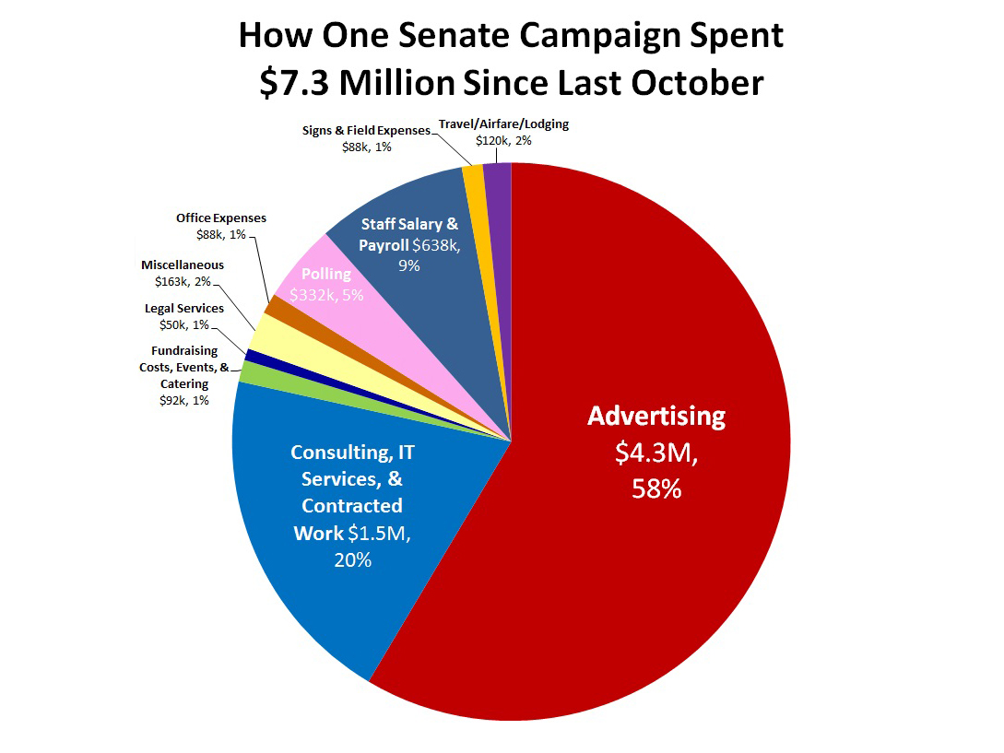

Slide 17
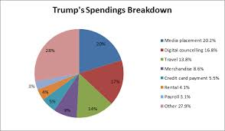

Slide 18
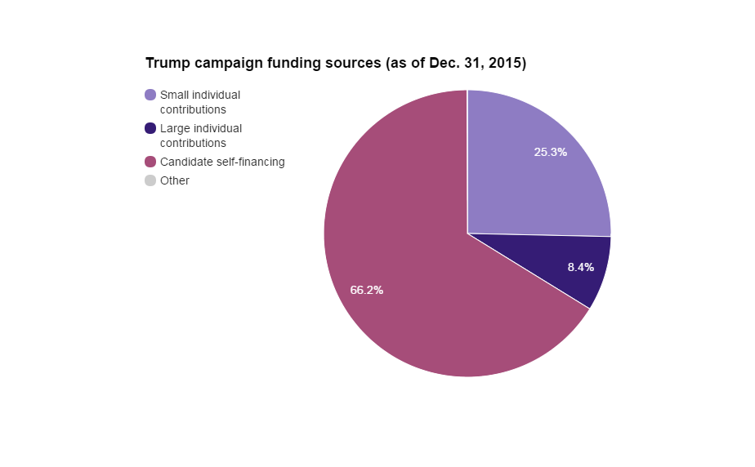

Slide 19
Where does the money come from?

Slide 20
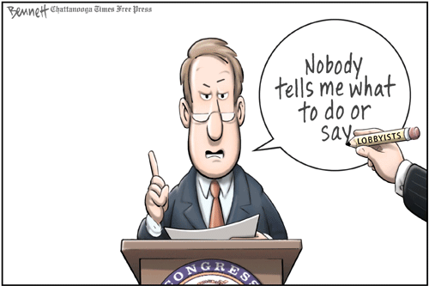
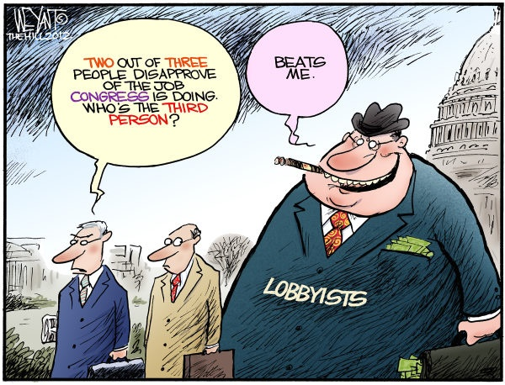
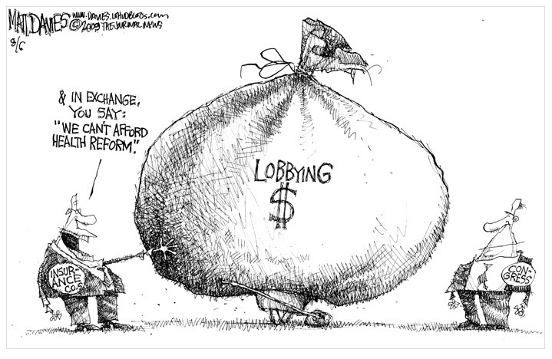

Slide 21
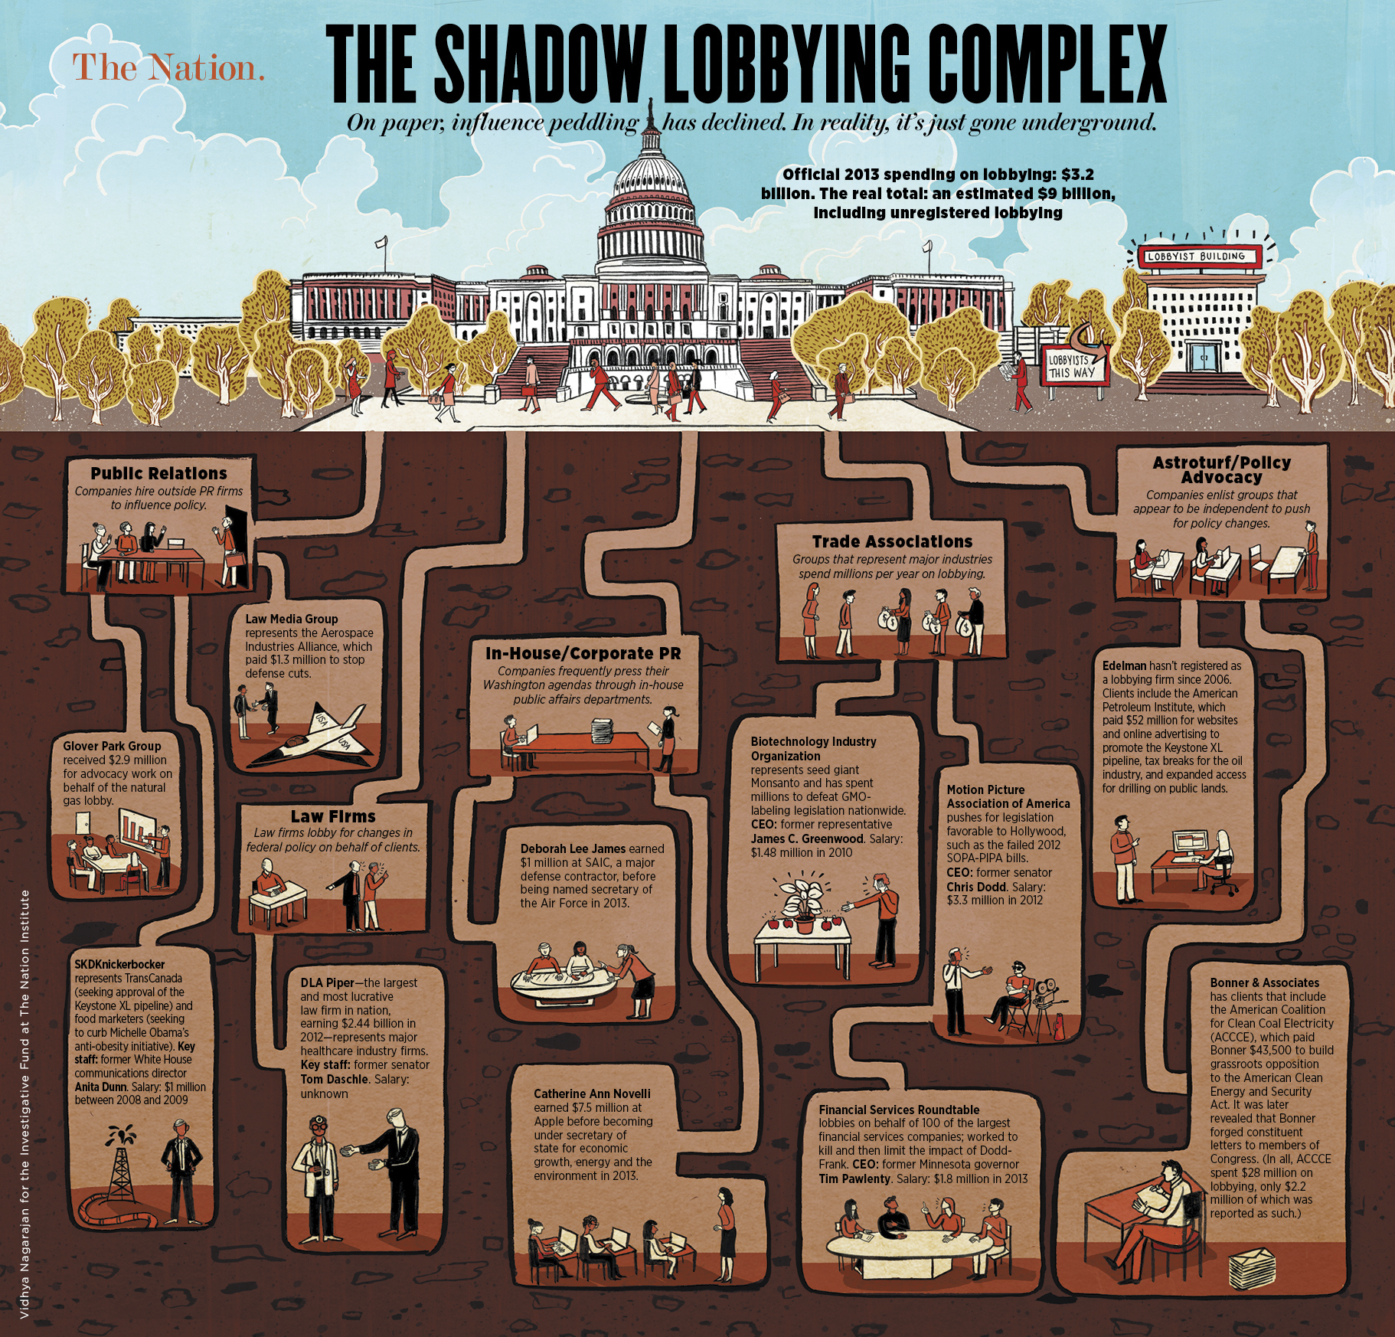

Slide 22
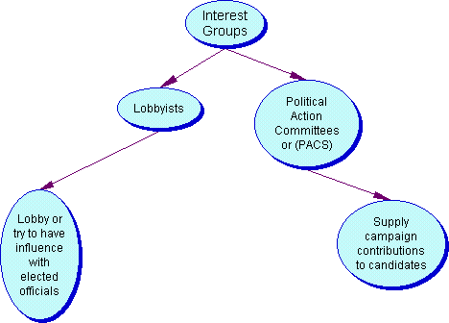
Special Interest Groups, Lobbyists and PACs

Slide 23
Top Contributors, federal election data for Hillary Clinton, 2016 cycle
This page shows contributions grouped by contributor to the candidate's campaign committee plus any super PACs or hybrid PACs working on his or her behalf
Contributor | Total
Paloma Partners | $21,613,800
Pritzker Group | $16,626,207
Renaissance Technologies | $14,040,200
Saban Capital Group | $12,283,375
Newsweb Corp | $11,016,642
Soros Fund Management | $10,554,093
S Daniel Abraham Center for Middle East Peace | $6,008,215
Asana | $6,005,556
Lone Pine Capital | $5,015,300
Carpenters & Joiners Union | $5,005,954
Laborers Union | $4,753,623
DE Shaw Research | $4,058,757
Plumbers/Pipefitters Union | $4,013,894

Slide 24
Top Contributors, federal election data for Donald Trump, 2016 cycle
This page shows contributions grouped by contributor to the candidate's campaign committee plus any super PACs or hybrid PACs working on his or her behalf
Contributor | Total
Renaissance Technologies | $15,511,600
McMahon Ventures | $6,002,700
GH Palmer Assoc | $5,005,400
Mountaire Corp | $2,013,500
Houston Texans | $2,010,800
Cerberus Capital Management | $1,492,560
Electroimpact Inc | $1,005,399
Buckley Muething Capital Management | $1,000,000
Clarium Capital | $1,000,000
Hawaiian Gardens Casino | $1,000,000
Auburn Manor Holding | $705,400
Rhs Investments (Hank Seale) | $500,000
Murray Energy | $302,734
Hamilton Co | $300,056
GEO Group | $281,360

Slide 25
Thank You for Smoking
https://www.amazon.com/Thank-You-Smoking-Aaron-Eckhart/dp/B003MX8RJS/ref=sr_1_1?ie=UTF8&qid=1511279427&sr=8-1&keywords=thank+you+for+smoking+movie&dpID=51YIJHcaPFL&preST=_SY300_QL70_&dpSrc=srch

Slide 26
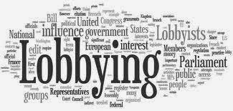
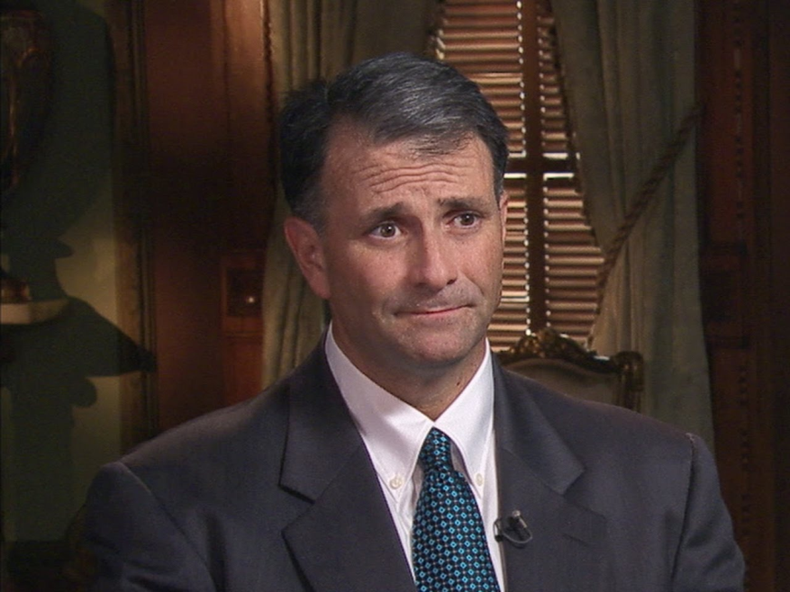
Lobbyists
http://pbseduelectioncentral.com/we-the-voters.html
https://www.youtube.com/watch?v=CHiicN0Kg10

Slide 27
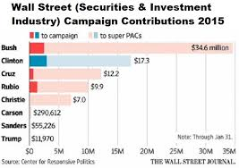

Slide 28
http://fortune.com/2016/12/09/hillary-clinton-donald-trump-campaign-spending/

