Slide 1
Barriers & Contraceptives
Women, men, or couples at a given point in their lifetimes will need to choose the most appropriate contraceptive method. These elements include safety, effectiveness, availability and acceptability.

Slide 2
Barrier is a barrier. It is blocking something and not allowing something to get through or escape.
Contraceptives are hormonally based. Basically tricking the female’s body into thinking it is already pregnant based on the dosage of hormones.

Slide 3
Personal Responsibility to your Health!
When choosing a method of contraception, protection from the risk for HIV and other STDs should always be considered. Although hormonal contraceptives and IUDs are highly effective at preventing pregnancy, they do not protect against STDs or HIV. Consistent and correct use of the male latex condom reduces the risk for HIV and other STDs.

Slide 4
IUD Intrauterine Device
Levonorgestrel intrauterine system (LNG IUD)—A small T-shaped device like the Copper T IUD. It is placed inside the uterus by a doctor.
It releases a small amount of progestin each day to keep you from getting pregnant. This stays in your uterus for up to 3 to 6 years, depending on the device.
Typical use failure rate: 0.1-0.4%
Copper T intrauterine device (IUD)—A small device that is shaped in the form of a “T.” A doctor places it inside the uterus to prevent pregnancy.
It can stay in your uterus for up to 10 years.
Typical use failure rate: 0.8%
No STD Protection

Slide 5
Hormonal Method
Thin rod that is inserted under the skin of a women’s upper arm.
The rod contains a progestin that is released into the body over 3 years.
Typical use failure rate: 0.01%.
No protection for STDS

Slide 6
Hormonal Method
Injection or “shot”
Women get shots of the hormone progestin in the buttocks or arm every three months from their doctor.
Typical use failure rate: 4%.
No STD protection

Slide 7
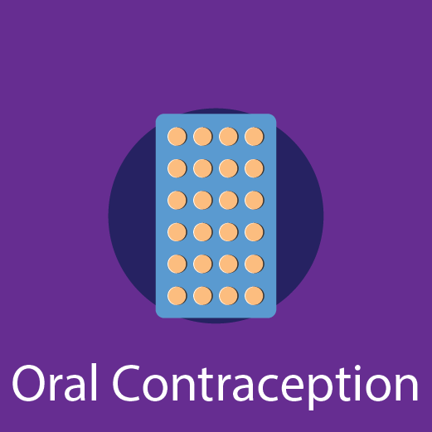
Birth Control Pill (Hormonal Method)
Combined oral contraceptives are also known as “the pill.”
Contain the hormones estrogen and progestin. Prescribed by a doctor.
A pill is taken at the same time each day.
If you are older than 35 years and smoke/vape, have a history of blood clots or breast cancer, your doctor may advise you not to take the pill.
Typical use failure rate: 7%.
Progestin only pill
Unlike the combined pill, the progestin-only pill (sometimes called the mini-pill) only has one hormone, progestin.It is prescribed by a doctor.
It is taken at the same time each day. It may be a good option for women who can’t take estrogen. Typical use failure rate: 7%.
No STD Protection

Slide 8
Skin Patch ( Hormonal Method)
This skin patch is worn on the lower abdomen, buttocks, or upper body (but not on the breasts).It releases hormones progestin and estrogen into the bloodstream. You put on a new patch once a week for 3 weeks. During the fourth week, you do not wear a patch, so you can have a menstrual period.
Typical use failure rate: 7%.
Prescribed by a doctor
No STD Protection

Slide 9
Hormonal Method
Contraceptive Ring
The ring releases the hormones progestin and estrogen.
You place the ring inside your vagina. You wear the ring for 3 weeks, take it out for the week you have your period, and then put in a new ring.
Typical use failure rate: 7%
No STD Protection

Slide 10
The Sponge (Barrier Method)
The contraceptive sponge contains spermicide and is placed in the vagina where it fits over the cervix. The sponge works for up to 24 hours, and must be left in the vagina for at least 6 hours after the last act of intercourse.
Then it is removed and discarded. No STD Protection.
Typical use failure rate: 14% for women who have never had a baby and 27% for women who have had a baby.

Slide 11
Barrier Method
Diaphragm or Cervical Cap—Each of these barrier methods are placed inside the vagina to cover the cervix to block sperm.
The Diaphragm is shaped like a shallow cup.
The Cervical Cap is a thimble-shaped cup.
Before sexual intercourse, you insert them with spermicide to block or kill sperm.
Visit your doctor for a proper fitting because diaphragms and cervical caps come in different sizes. Typical use failure rate is: 17%.
Spermicides- Products work by killing sperm and come in several forms: foam, gel, cream, film, suppository, or tablet.
There is NO STD protection when any of these methods are used.

Slide 12
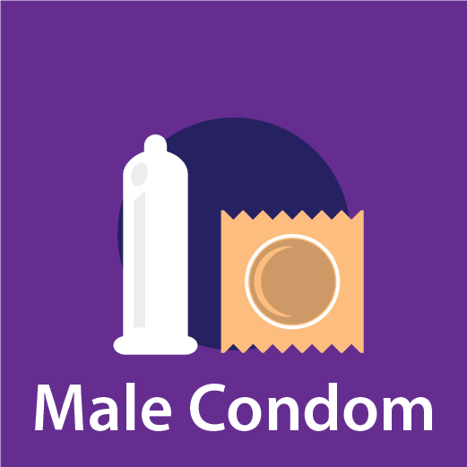
Male Condom (Barrier Method)
Most commonly used barrier/contraceptive method
Worn by the man, a male condom keeps sperm from getting into a woman’s body. Protects against pregnancy and STDS
Latex condoms typically have a 2% failure rate when used properly.
“Natural” or “lambskin” condoms also help prevent pregnancy, but may not provide protection against STDs, including HIV. Typical use failure rate: 13%.
Condoms can only be used once & have an expiration date!
Do not use oil-based lubricants such as massage oils, baby oil, lotions, or petroleum jelly with latex condoms. They will weaken the condom, causing it to tear or break! DO NOT “double up”, material weakens due to friction! Dropping effectiveness significantly and increasing failure rate!!

Slide 13
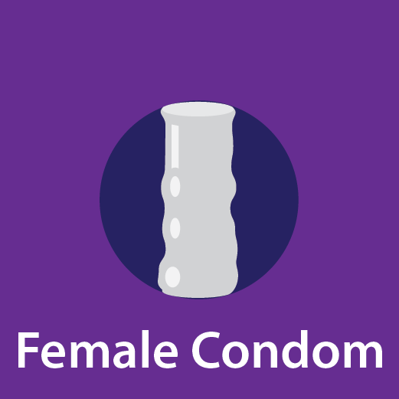
Female Condom (Barrier Method)
Worn by the woman, the female condom helps keeps sperm from getting into her body. It can be inserted up to 8 hours before sexual intercourse.
Typical use failure rate: 21%
Helps to prevent STDs and Pregnancy
CANNOT be used together with male condom. Friction weakens the materials causing holes allowing sperm to pass through.

Slide 14
Emergency Contraception (Plan B)
Emergency contraceptive pills can be taken up to 5 days after unprotected sex, but the sooner the pills are taken, the better they will work. Each day past the time of intercourse the effectiveness rate declines significantly.
There are three different types of emergency contraceptive pills available in the United States.
Some emergency contraceptive pills are available over the counter. No STD protection or treatment.

Slide 15
Permanent methods of Birth Control
Female Sterilization
Tubal ligation or “tying tubes”
A woman can have her fallopian tubes tied (or closed) so that sperm and eggs cannot meet for fertilization. The procedure can be done in a hospital or in an outpatient surgical center. You can go home the same day of the surgery and resume your normal activities within a few days.
This method is effective immediately.
Typical use failure rate: 0.5%. No STD prevention

Slide 16
Permanent Method of Birth Control
Male Sterilization–Vasectomy
This operation is done to keep a man’s sperm from going to his penis, so his ejaculate never has any sperm in it that can fertilize an egg.
The procedure is typically done at an outpatient surgical center. The man can go home the same day. Recovery time is less than one week. After the operation, a man visits his doctor for tests to count his sperm and to make sure the sperm count has dropped to zero; this takes about 12 weeks.
Another form of birth control should be used until the man’s sperm count has dropped to zero. Typical use failure rate: 0.15%. No STD protection.

Slide 17
Center for Disease Control
https://www.cdc.gov/reproductivehealth/contraception/index.htm
For additional information & resources please visit the cdc.gov for the most current up to date data and statistics regarding these barrier and contraceptive methods available in the United States.

