Slide 2
How Special Interest Groups Influence the Public
The goal of special interest groups is to influence public opinion
To gain members
To convince public of the importance of their cause
To get candidates elected who share the same beliefs as they do (Political Action Committees)
Techniques Used
Direct mail (junk mail)
Advertisements
Protests
Public events
Propaganda: certain ideas that may involve misleading messages designed to manipulate people

Slide 3
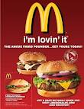
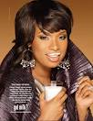
What do all these pictures have in common?

Slide 5
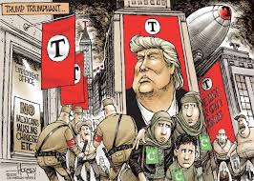
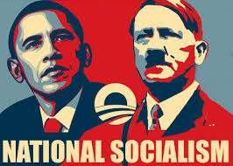

Slide 6
Persuasive Techniques
PROPAGANDA: techniques used to influence opinions, emotions, attitudes or behavior.

Slide 7
https://www.youtube.com/watch?v=Iu_JqNdp2As
NRA https://www.youtube.com/watch?v=9g0dnxLGW8M
NRA https://www.youtube.com/watch?v=HqhyWd0ZqNs
Chamber of Commerce
https://www.youtube.com/watch?v=ItHzErlf_9I

Slide 8
https://youtu.be/mRY3njcGgWU
https://youtu.be/VdzeTq6YPg0
https://youtu.be/nG4IX5jBc4Q

Slide 9
What is persuasion?
Generally an appeal to emotion, not intellect.
An attempt to change your behavior
It attempts to “guide your choice”

Slide 12
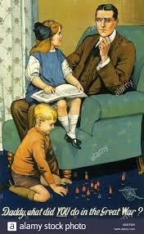

Slide 13
National organization for Marriage
Planned Parenthood https://www.youtube.com/watch?v=lEFQEinyK4o
National Organization of Marriage
https://www.youtube.com/watch?v=4AzLrn5JVIo

Slide 14
CNN 10 North Korea
http://www.cnn.com/2017/11/29/cnn10/ten-content-thurs/index.html
National Geograpic
https://www.youtube.com/watch?v=AlJUGZPanB8 (40)
Frontline
https://www.pbs.org/wgbh/frontline/film/north-koreas-deadly-dictator/

Slide 15
Who uses propaganda?
Military
Media
Advertisers
Politicians
You and I!!!

Slide 16
Propaganda Techniques
Bandwagon Technique
Testimonial
Loaded Word
Misuse of statistics
Name calling or stereotyping
Plain Folks
Snob Appeal
Transfer

Slide 17
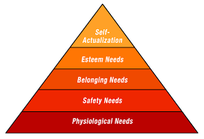
Maslow’s Hierarchy of Needs

Slide 18
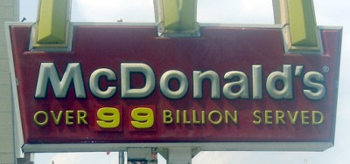
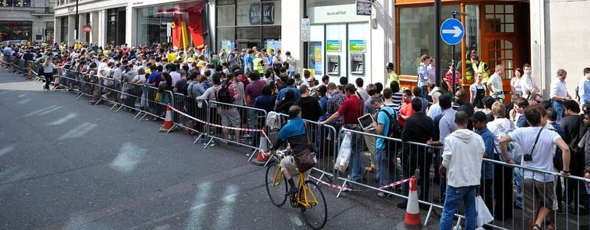
Bandwagon Technique
Everyone is doing it! You should too!!!
Appeals to people’s desire to be part of the “winning team”
Ex. “Polls show our candidate is pulling ahead, and we expect to win by a landslide”

Slide 19
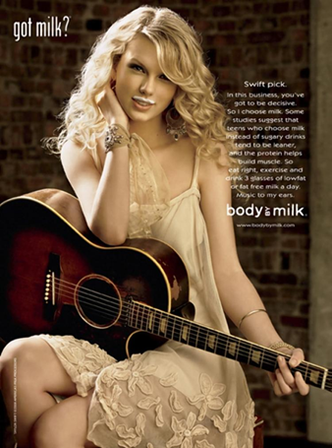
Testimonial
Testimonials are quotations or endorsements which connect a famous or respectable person with a product or item.
https://www.youtube.com/watch?v=B3aqajRVi3U
\

Slide 21
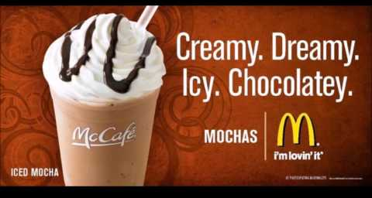
Loaded Words
Use “loaded” words like . . .
new
improved
best

Slide 22
Misuse of Statistics
When the statistics are based on a falsehood.

Slide 23
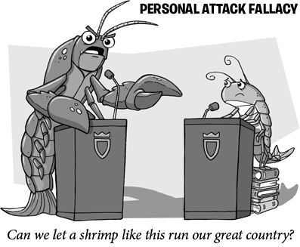
Name Calling or stereotyping
Smears or Damages an Opponent
Often Used By Politicians and Special Interest Groups
Tree Hugger
Gun Nut
Flip Flopper
Liar

Slide 24
Plain Folks
Makes the leaders look like
Plain folks (mom and pop style)
a convincing method to show they are just common people.
Opposite of snob appeal

Slide 25
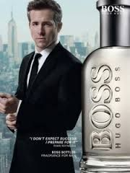
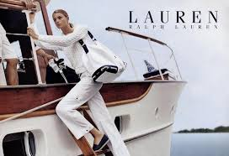
Snob Appeal
aims to flatter
this product is better than others.
Cutting edge, ahead of the times.
Not everyone can have or appreciate it
Desire to achieve status

Slide 26
Transfer
-Feelings (good or bad)
are transferred to something else.
Transfer tries to make you view something in the same way as they view something else.
In the Kerry vs. Bush campaign, Kerry was compared to Frankenstein

Slide 27
Stacked Cards:
presents only one side of an issue
Ex. “Candidate A has the best record on the environment”

Slide 28
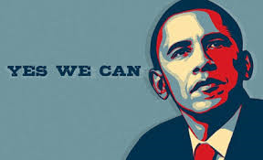
Glittering Generalities
a statement that sounds good but is essentially meaningless
Ex. “Candidate A is the one to bring us peace and prosperity

Slide 29
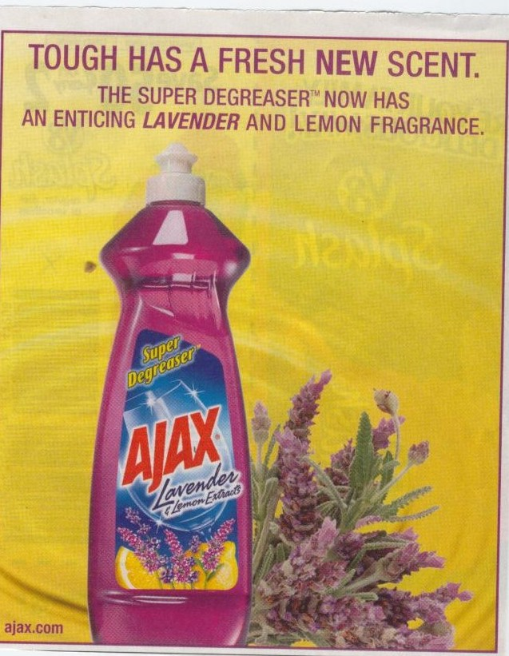
PRACTICE: What type of propaganda technique is used in the following ad?
Bandwagon
Loaded Words
Testimonial
Name-Calling
Plain Folks
Snob Appeal
Misuse of Statistics
Transfer
Glittering Generalities
Card Stacking

Slide 30
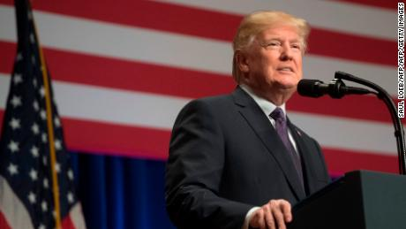
1. What type of Propaganda
Public opposition to tax bill grows
CNN POLL
Nearly two-thirds of Americans say the bill favors the wealthy, a CNN poll finds
The day the GOP has been seeking: Voting begins today on plan
How much will you pay under GOP tax plan? It depends
The current tax brackets vs the GOP tax plan
Ivanka Trump trumpets tax bill in interview
Mike Pence delays trip to Israel and Egypt as tax vote nears

Slide 31
2. What type of Propaganda

Slide 32
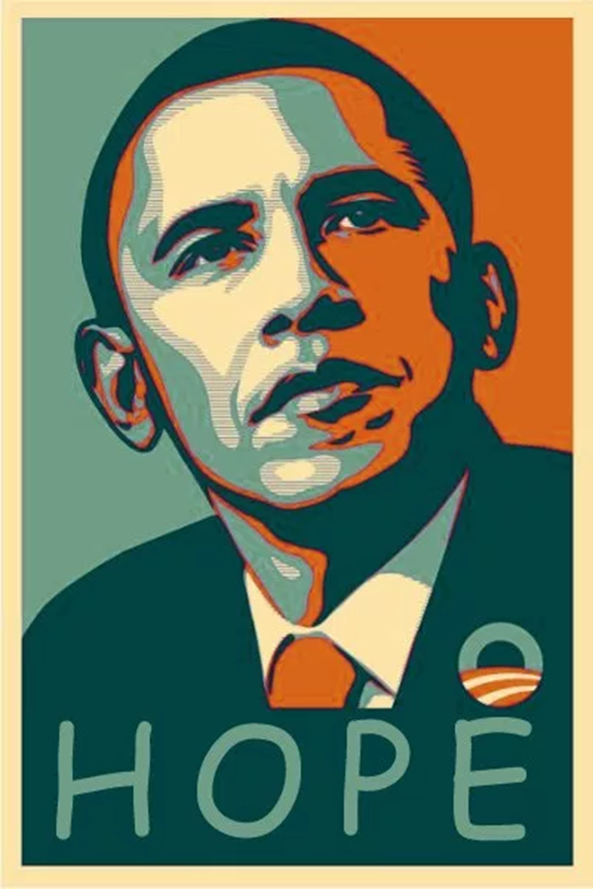
3

Slide 33
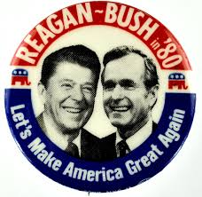
4

Slide 34
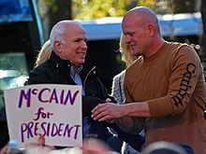
5

Slide 35
6

Slide 36
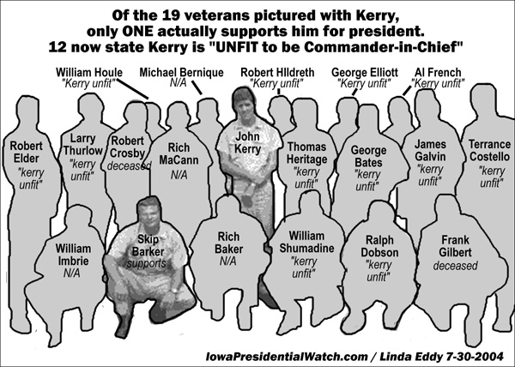
6

Slide 37
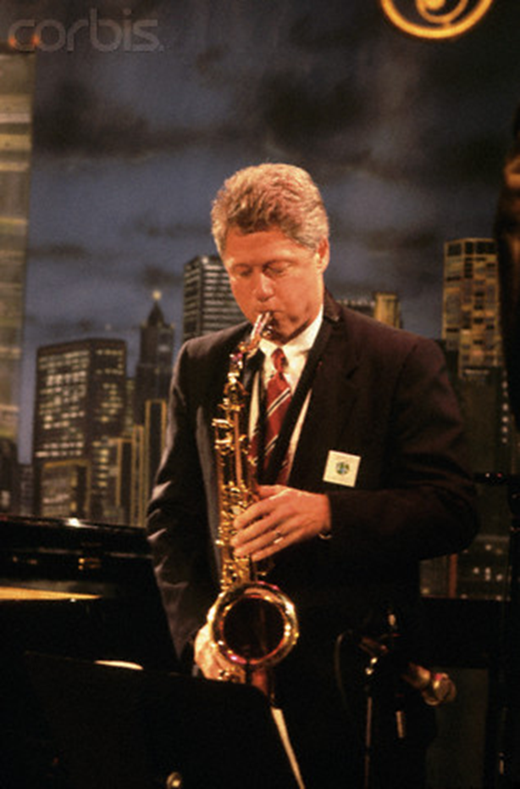
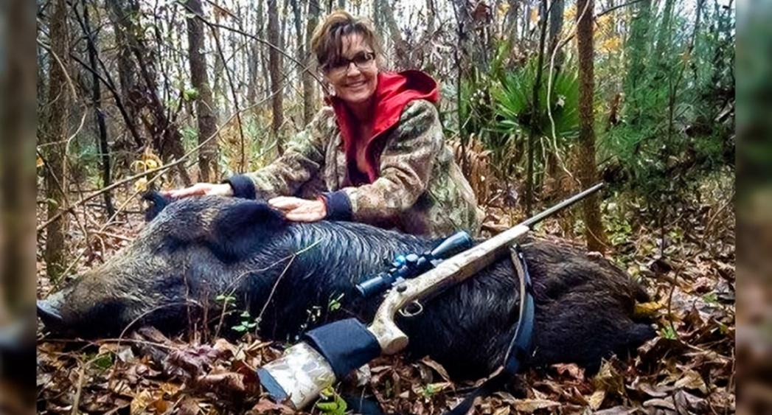
7

Slide 38
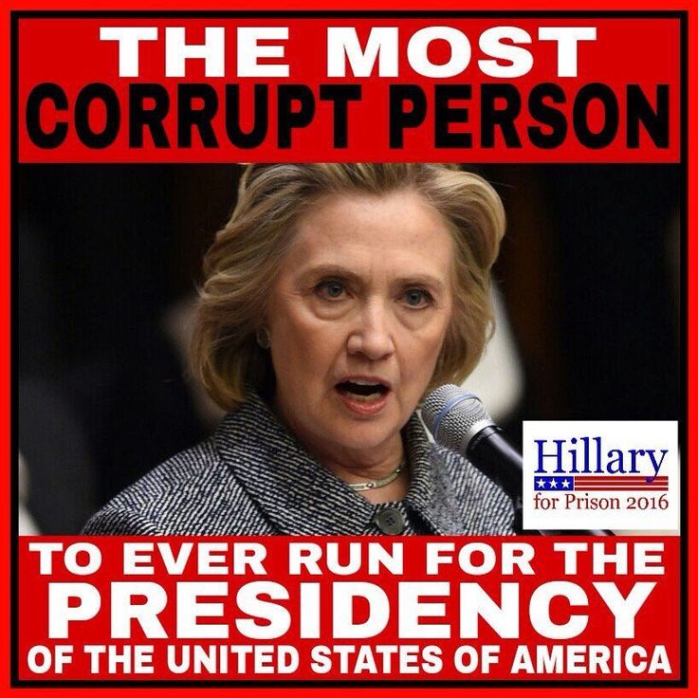
8

Slide 39
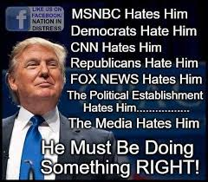
What type of Propaganda

Slide 40
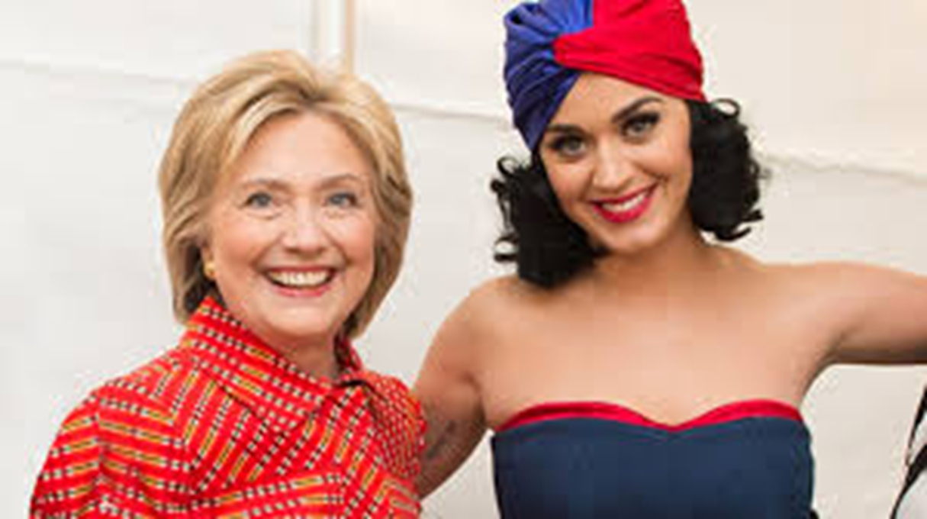
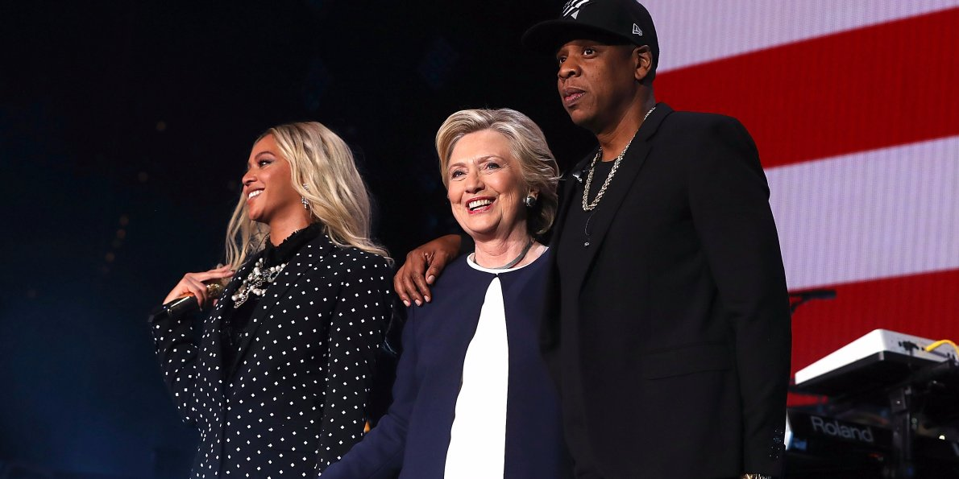
10

Slide 41
11 What type of Propaganda

Slide 42
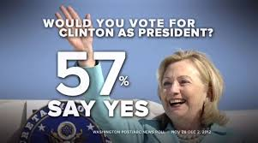
12

Slide 43
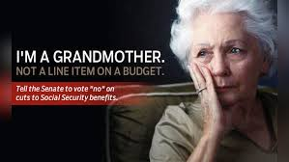
13

Slide 44
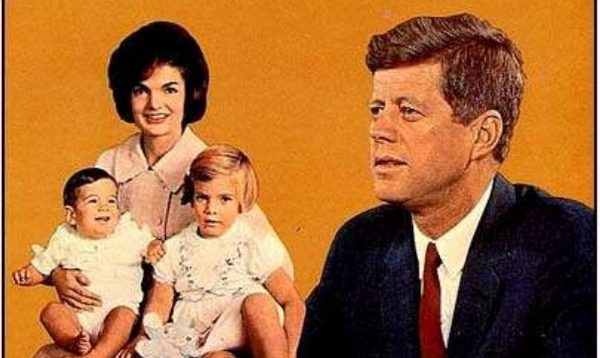
14

Slide 45
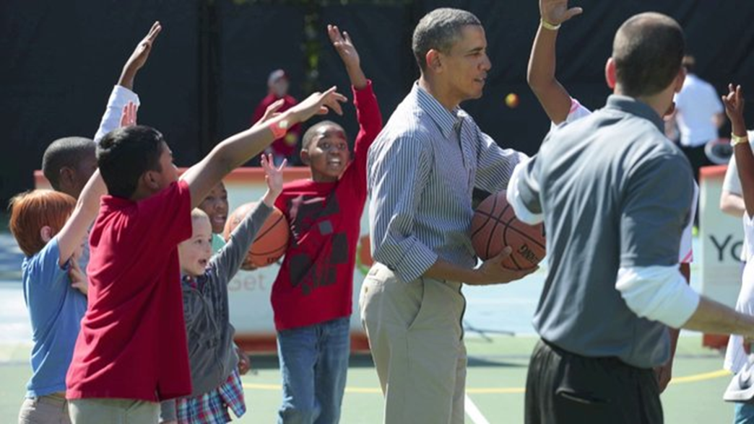
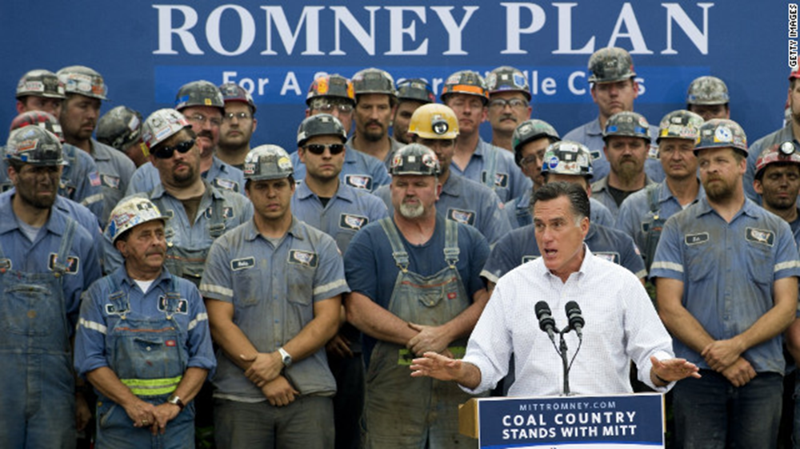
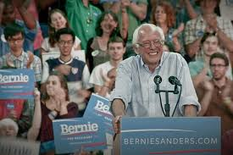
15

Slide 46
16

Slide 47
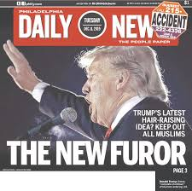
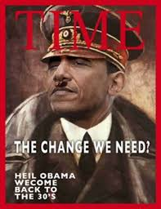
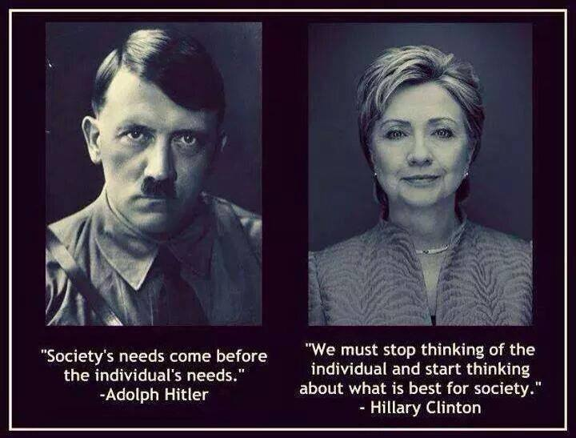
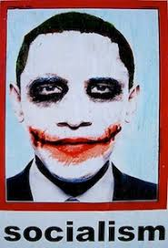
17

Slide 48
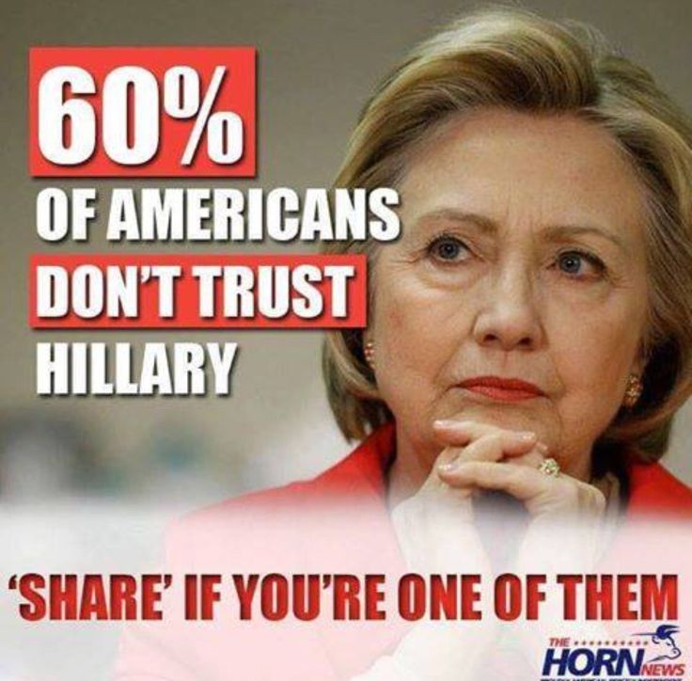
18

Slide 49
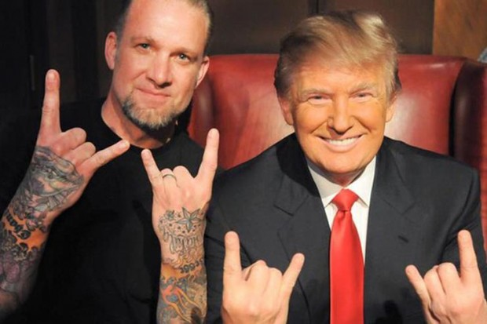
19

Slide 50
20

Slide 51
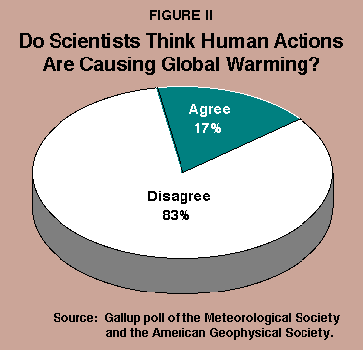
22

Slide 52
23
https://www.youtube.com/watch?v=vST61W4bGm8

Slide 53
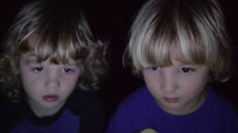
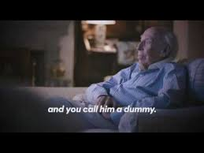
24 & 25
https://www.youtube.com/watch?v=mrX3Ql31URA
https://www.youtube.com/watch?v=RaxNEzA3jRs

Slide 55
https://www.youtube.com/watch?v=HqBVLJWxoWQ

Slide 56
Propaganda Techniques Cont’d
Stacked Cards: presents only one side of an issue
Ex. “Candidate A has the best record on the environment”
Glittering Generality: a statement that sounds good but is essentially meaningless
Ex. “Candidate A is the one to bring us peace and prosperity
Just Plain Folks: use of photographs of candidates to make people think of that the candidate is just like the, with the same desires and concerns
Ex. “My parents were ordinary, hardworking people, and they taught me those very same values.”

Slide 57
Propaganda Techniques Cont’d
Stacked Cards: presents only one side of an issue
Ex. “Candidate A has the best record on the environment”
Glittering Generality: a statement that sounds good but is essentially meaningless
Ex. “Candidate A is the one to bring us peace and prosperity
Just Plain Folks: use of photographs of candidates to make people think of that the candidate is just like the, with the same desires and concerns
Ex. “My parents were ordinary, hardworking people, and they taught me those very same values.”

Slide 58
Propaganda Techniques Cont’d
Transfer/Symbols: using a patriotic symbol to associate with the candidate
Ex. The candidate wearing blue and red standing in front of an American flag.

