Slide 2
5
Merchandising Operations and the Multiple-Step Income Statement
Kimmel ● Weygandt ● Kieso
Financial Accounting, Eighth Edition

Slide 3
CHAPTER OUTLINE
LEARNING OBJECTIVES
Describe merchandising operations and inventory systems.
1
Record purchases under a perpetual inventory system.
2
Record sales under a perpetual inventory system.
3
Prepare a multiple-step income statement and a comprehensive income statement.
4
Determine cost of goods sold under a periodic inventory system.
5
Compute and analyze gross profit rate and profit margin.
6

Slide 4
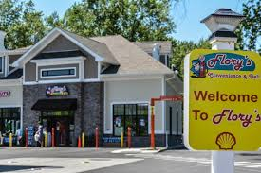
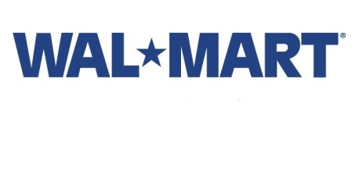
LEARNING OBJECTIVE
1
Describe merchandising operations and inventory systems.
Merchandising Companies
Buy and Sell Goods
Retailer
Wholesaler
Consumer
The primary source of revenues is referred to as sales revenue or sales.
LO 1

Slide 5
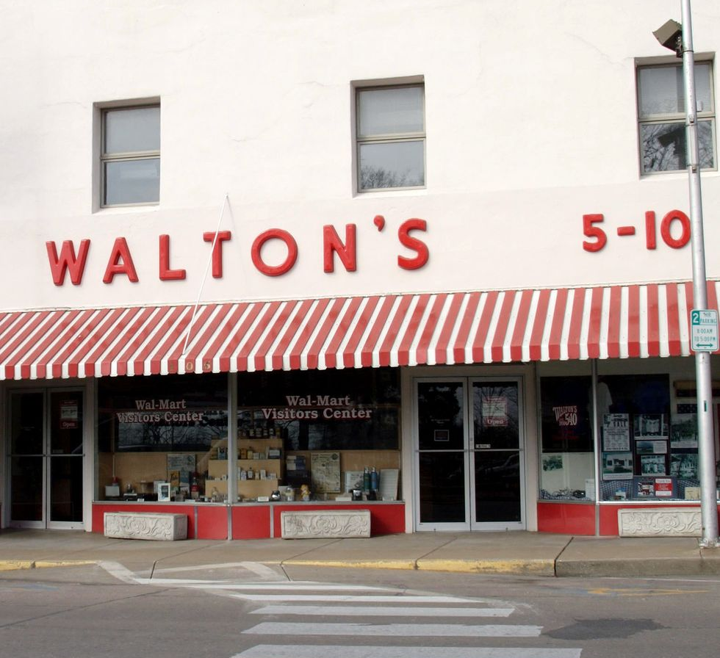
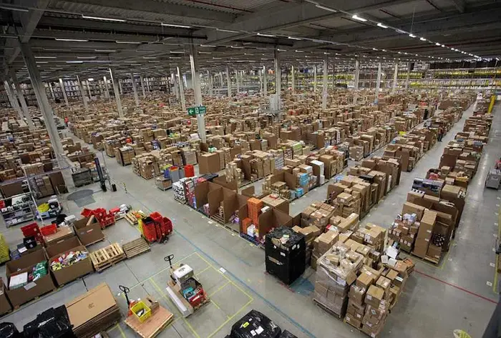
LEARNING OBJECTIVE
1
Describe merchandising operations and inventory systems.
Merchandising Companies
Buy and Sell Goods
Does retail $ound boring?
90% of the population in the US lives within 10 miles of a Walmart store
$500 billion in sales and has more than 2 million employees.
~$60,000,000 in sales/hour
~99.73% of the US population has access to Broadband Internet
does more than $60 billion in sales
First sale was from Bezo’s garage
In 2018, held 49% of the ecommerce market.
LO 1

Slide 6
LEARNING OBJECTIVE
1
Describe merchandising operations and inventory systems.
Expenses for a merchandiser are divided into two categories:
1 Cost of goods sold
The total cost of merchandise sold during the period
2 Operating expenses
Expenses incurred in the process of earning sales revenue (i.e. sales salaries, rent, utilities expense)

Slide 7
Merchandising Company
Income Measurement
Sales
Revenue
These not used in a Service business.
Less
Cost of
Goods Sold
Equals
Gross
Profit
Less
Operating
Expenses
Net
Income
(Loss)
Cost of goods sold is the total cost of merchandise sold during the period.
Equals
LO 1

Slide 8
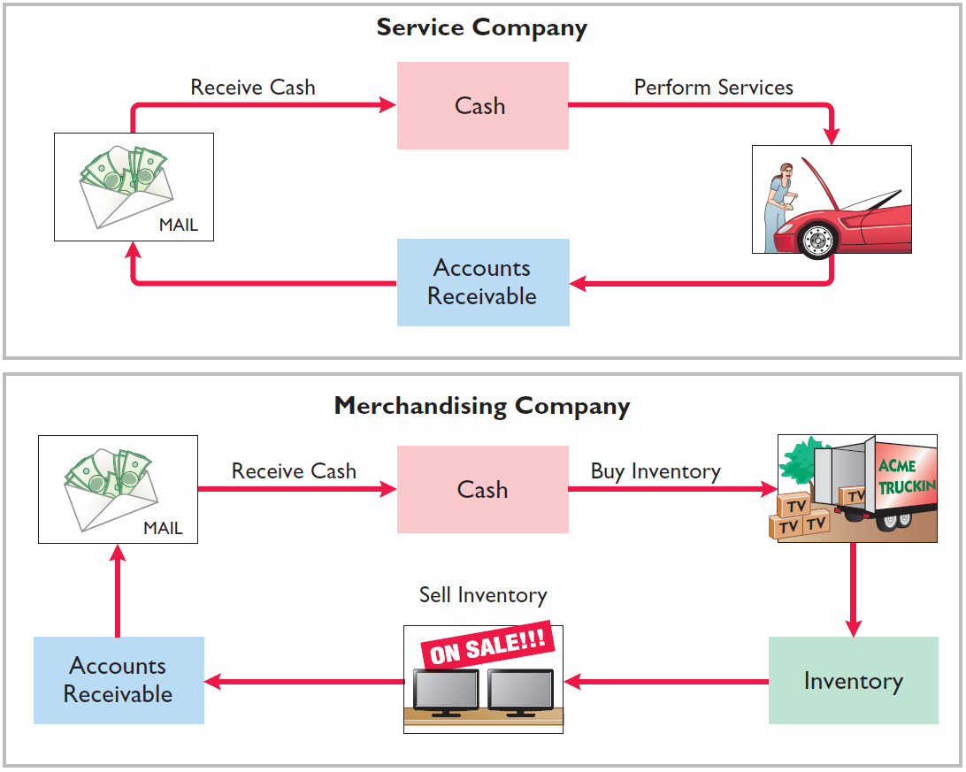
OPERATING CYCLES
ILLUSTRATION 5-2
Operating cycles for a service company and a merchandising company
LO 1

Slide 9
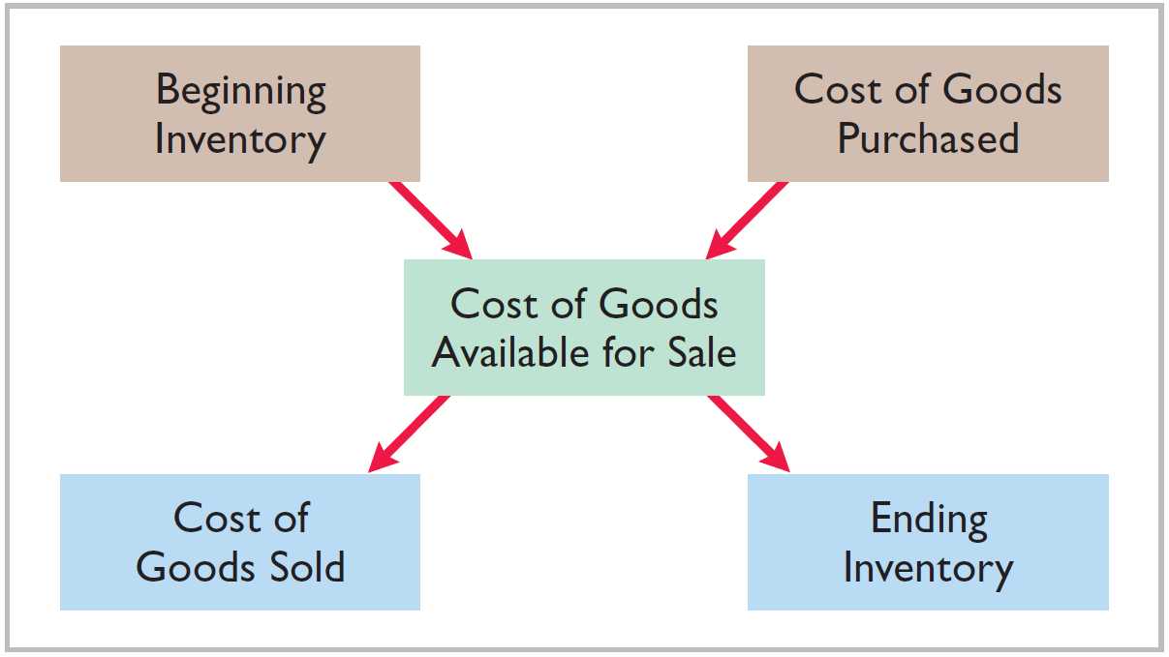
FLOW OF COSTS
ILLUSTRATION 5-3
Flow of costs
Companies use either a perpetual inventory system or a periodic inventory system to account for inventory.
LO 1

Slide 10
FLOW OF COSTS
Periodic System
Do not keep detailed records of the goods on hand.
Cost of goods sold determined by count at the end of the accounting period.
Calculation of Cost of Goods Sold:
Beginning inventory $ 100,000
Add: Purchases, net 800,000
Goods available for sale 900,000
Less: Ending inventory 125,000
Cost of goods sold $ 775,000
LO 1

Slide 11
Inventory Systems - Periodic System
Features:
Purchases of merchandise increase Purchases.
Ending Inventory determined by physical count.
Calculation of Cost of Goods Sold:
Beginning inventory (Oct 1) $ 400,000
+ Purchases, net (Oct1-31) 500,000
= Goods Available for Sale 900,000
- Ending inventory (Oct 31) 200,000
= Cost of goods sold $ 700,000
Hint:
BP = GAS
Dan Paunovic

Slide 12
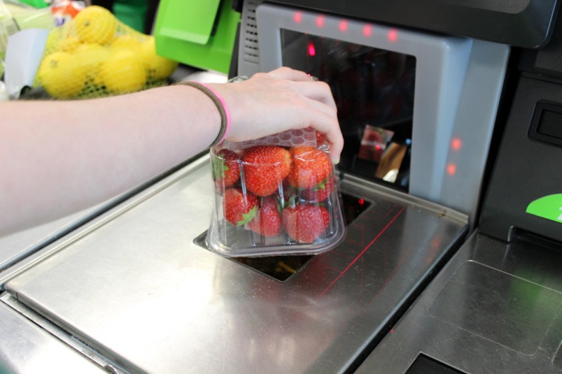
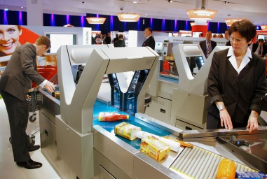
FLOW OF COSTS
Perpetual System – “Beep”
Maintain detailed records of the cost of each inventory purchase and sale.
Records continuously show inventory that should be on hand for every item.
Company determines cost of goods sold each time a sale occurs.
LO 1

Slide 13
FLOW OF COSTS
Advantages of the Perpetual System
Traditionally used for merchandise with high unit values.
Shows the quantity and cost of the inventory that should be on hand at any time.
Provides better control over inventories than a periodic system.
LO 1

Slide 14
INVESTOR INSIGHT
Morrow Snowboards, Inc.
Improve Stock Appeal
Investors are often eager to invest in a company that has a hot new product. However, when snowboard maker Morrow Snowboards, Inc. issued shares of stock to the public for the first time, some investors expressed reluctance to invest in Morrow because of a number of accounting control problems. To reduce investor concerns, Morrow implemented a perpetual inventory system to improve its control over inventory. In addition, it stated that it would perform a physical inventory count every quarter until it felt that its perpetual inventory system was reliable.
LO 1

Slide 15
DO IT!
1
Merchandising Operations and Inventory Systems
Indicate whether the following statements are true or false. If false, indicate how to correct the statement.
The primary source of revenue for a merchandising company results from performing services for customers.
The operating cycle of a service company is usually shorter than that of a merchandising company.
Sales revenue less cost of goods sold equals gross profit.
Ending inventory plus the cost of goods purchased equals cost of goods available for sale.
False
(service company)
True
True
False
(Beg. Inventory + COGS)
LO 1

Slide 16
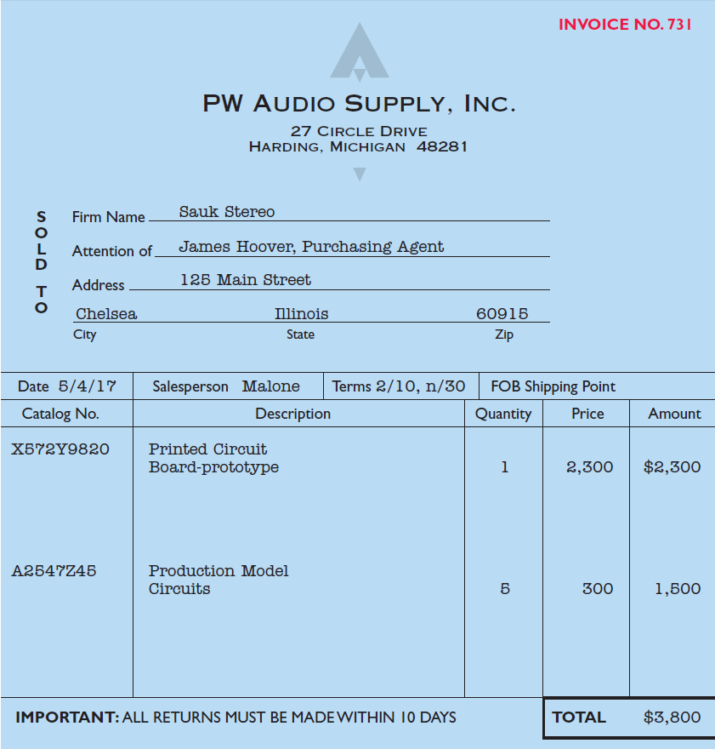
LEARNING OBJECTIVE
2
Record purchases under a perpetual inventory system.
Made using cash or credit (on account).
Normally record when goods are received from the seller.
Purchase invoice should support each credit purchase.
ILLUSTRATION 5-5
Sales invoice used as
Purchase invoice by Sauk Stereo
LO 2

Slide 17
CHEAT SHEET – Inventory Systems (Perpetual)
Any purchases increase Merchandise Inventory.
Freight costs increase Merchandise Inventory.
Purchase Returns and Allowances and Purchase Discounts decrease Merchandise Inventory.
Discounts received as a result of early payment
decrease Merchandise Inventory.
Note: For each sale… Cost of Goods Sold is increased and Merchandise Inventory is decreased.
Note: Physical count done to verify Merchandise Inventory balance.
The perpetual inventory system provides a continuous record of Merchandise Inventory and Cost of Goods Sold.
LO 1 Identify the differences between service and merchandising companies.

Slide 18
PURCHASES – Purchasing Merchandise Inventory for future sale
LO 2

Slide 19
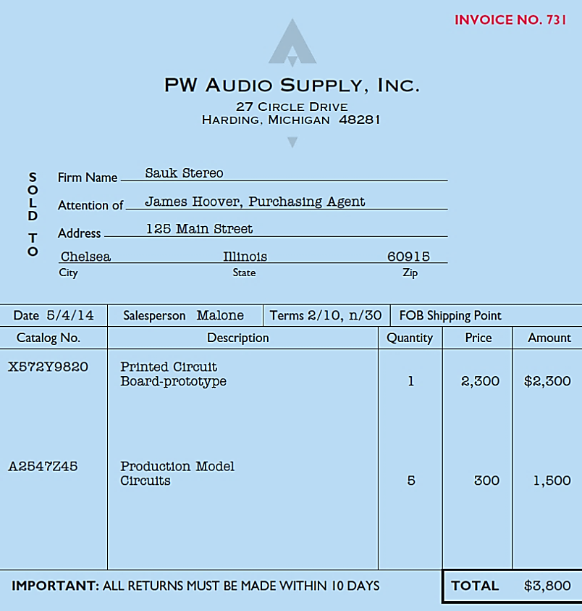
Record Purchase of Merchandise
ILLUSTRATION 5-5
Illustration: Sauk Stereo (the buyer) uses as a purchase invoice the sales invoice prepared by PW Audio Supply, Inc. (the seller).
CHAPTER 3: Prepare the journal entry for Sauk Stereo for the invoice from PW Audio Supply.
May 4
Inventory 3,800
Accounts Payable 3,800
LO 2

Slide 20
FREIGHT COSTS… is part of the inventory cost
How much does this item cost?

Slide 21
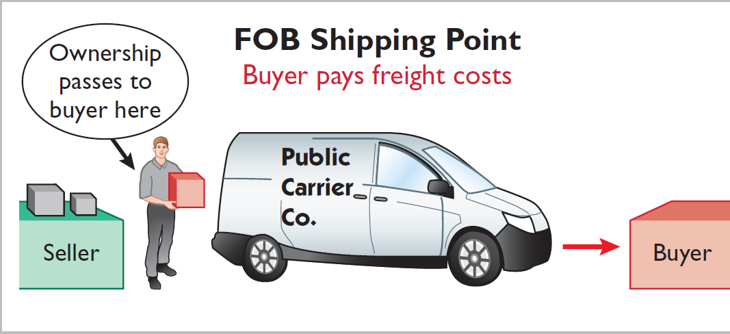
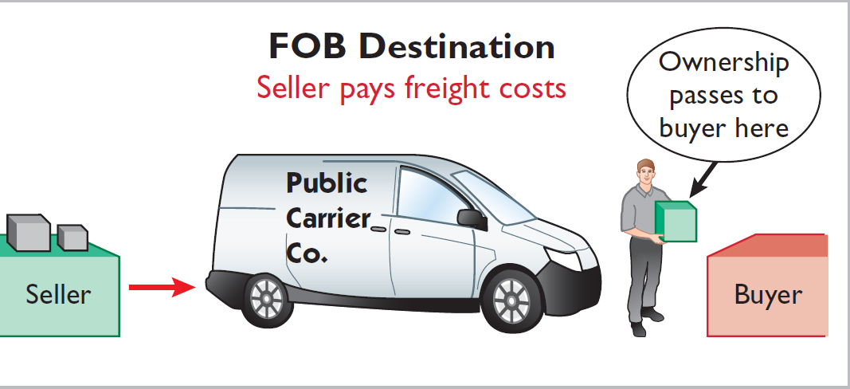
FREIGHT COSTS
ILLUSTRATION 5-6
Shipping terms
Ownership of the goods passes to the buyer when the public carrier accepts the goods from the seller.
Ownership of the goods remains with the seller until the goods reach the buyer.
Freight costs incurred by the seller are an operating expense.
LO 2

Slide 22
FREIGHT COSTS – WHO PAYS FOR THEM?
"Free shipping"
FOB Destination - seller places the goods Free On Board to the buyer’s place of business, and seller pays freight costs… buyer doesn’t.
Nate Cruz
Sam Gisonni
FOB Shipping Point - seller places goods Free On Board
the carrier, and buyer pays freight costs.

Slide 23
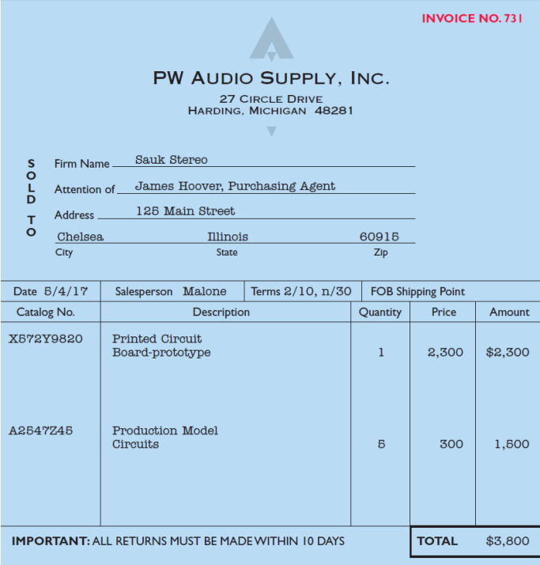
Record Purchase of Merchandise
ILLUSTRATION 5-5
CHAPTER 3: Prepare the journal entry for Sauk Stereo for the invoice from PW Audio Supply.
May 4
Merchandise Inventory 3,800
Accounts Payable 3,800
LO 2

Slide 24
FREIGHT COSTS
Illustration: Assume upon delivery of the goods on May 6, Sauk Stereo (Buyer) pays Public Freight Company $150 for freight charges, the entry on Sauk Stereo’s books is:
May 6
Merchandise Inventory 150
Cash 150
Assume the freight terms on the invoice in Illustration 5-5 had required PW Audio Supply (Seller) to pay the freight charges, the entry by PW Audio Supply would be:
May 4
Freight-out 150
Cash 150
LO 2

Slide 25
PURCHASE RETURNS AND ALLOWANCES
LO 2

Slide 26
PURCHASE RETURNS AND ALLOWANCES
Goods can be returned for because: damaged or defective, of inferior quality, or do not meet specifications.
A Purchase Return
A Purchase Allowance
Buyer returns goods for credit if the sale was made on credit, or for a cash refund if the purchase was for cash.
Buyer chooses to keep the merchandise and the seller grants an allowance (deduction) from the purchase price.
LO 2 Explain the recording of purchases under a perpetual inventory system.

Slide 27
PURCHASE RETURNS AND ALLOWANCES
Purchaser may be dissatisfied because goods are damaged or defective, of inferior quality, or do not meet specifications.
Purchase Return
Purchase Allowance
Return goods for credit if the sale was made on credit, or for a cash refund if the purchase was for cash.
May choose to keep the merchandise if the seller will grant a reduction of the purchase price.
LO 2

Slide 28
PURCHASE RETURNS AND ALLOWANCES
Illustration: Assume Sauk Stereo returned goods costing $300 to PW Audio Supply on May 8.
May 8
Accounts Payable 300
Inventory 300
LO 2

Slide 29
PURCHASE RETURNS AND ALLOWANCES
Review Question
In a perpetual inventory system, a return of defective merchandise by a purchaser is recorded by crediting:
Purchases
Purchase Returns
Purchase Allowance
Inventory
LO 2

Slide 30
PURCHASE DISCOUNTS
2/10, n/30
1/10 EOM
n/10 EOM
2% discount if paid within 10 days, otherwise net amount due within 30 days.
1% discount if paid within first 10 days of next month.
Net amount due within the first 10 days of the next month.
LO 2

Slide 31
PURCHASE DISCOUNTS
Credit terms may permit buyer to claim a cash discount for prompt payment.
Advantages:
Purchaser saves money.
Seller shortens the operating cycle by converting the accounts receivable into cash earlier.
Example: : Credit terms of 2/10, n/30, is read “two-ten, net thirty.” 2% cash discount if payment is made within 10 days.
LO 2

Slide 32
CHEAT SHEET – Inventory Systems (Perpetual)
Any purchases increase Merchandise Inventory.
Freight costs increase Merchandise Inventory.
Purchase Returns and Allowances and Purchase Discounts decrease Merchandise Inventory.
Discounts received as a result of early payment
decrease Merchandise Inventory.
Note: For each sale… Cost of Goods Sold is increased and Merchandise Inventory is decreased.
Note: Physical count done to verify Merchandise Inventory balance.
The perpetual inventory system provides a continuous record of Merchandise Inventory and Cost of Goods Sold.
LO 1 Identify the differences between service and merchandising companies.

Slide 33
PURCHASE DISCOUNTS
Illustration: Assume Sauk Stereo pays the balance due of $3,500 (gross invoice price of $3,800 less purchase returns and allowances of $300) on May 14, the last day of the discount period. Prepare the journal entry Sauk Stereo makes on May 14 to record the payment.
Helper: (Discount = $3,500 x 2% = $70)
May 14
Accounts Payable 3,500
Inventory 70
Cash 3,430
LO 2

Slide 34
PURCHASE DISCOUNTS
Illustration: If Sauk Stereo failed to take the discount, and instead made full payment of $3,500 on June 3, the journal entry would be:
June 3
Accounts Payable 3,500
Cash 3,500
LO 2

Slide 35
PURCHASE DISCOUNTS
Should discounts be taken when offered?
Example: 2% for 20 days = Annual rate of 36.5%
($3,500 x 36.5% x 20) ÷ 365 = $70
LO 2

Slide 36
PURCHASING TRANSACTIONS
4th - Purchase
$3,800
$300
8th - Return
6th – Freight-in
150
70
14th - Discount
Balance
$3,580
LO 2

Slide 37
DO IT!
2
Purchase Transactions
On September 5, De La Hoya Company buys merchandise on account from Junot Diaz Company. The purchase price of the goods paid by De La Hoya is $1,500. On September 8, De La Hoya returns defective goods with a selling price of $200. Record the transactions on the books of De La Hoya Company.
SOLUTION
Sept. 5
Inventory 1,500
Accounts Payable 1,500
Sept. 8
Accounts Payable 200
Inventory 200
LO 2

Slide 38
LEARNING OBJECTIVE
3
Record sales under a perpetual inventory system.
Sales may be made on credit or for cash.
ILLUSTRATION 5-5
Sales revenue, like service revenue, is recorded when the performance obligation is satisfied.
Performance obligation is satisfied when the goods are transferred from the seller to the buyer.
Sales invoice should support each credit sale.
LO 3

Slide 39
Recording Sales
We’ve been doing this!
Journal Entries to Record a Sale
#1
Accounts Receivable or Cash XXX
Selling Price
Sales Revenue XXX
#2
Cost of Goods Sold XXX
Cost
Inventory XXX
This is new.
LO 3

Slide 40
Recording Sales
Illustration: PW Audio Supply records the sale of $3,800 on May 4 to Sauk Stereo on account (Illustration 5-5) as follows (assume the merchandise cost PW Audio Supply $2,400).
May 4
Accounts Receivable 3,800
Sales Revenue 3,800
4
Cost of Goods Sold 2,400
Inventory 2,400
LO 3

Slide 41
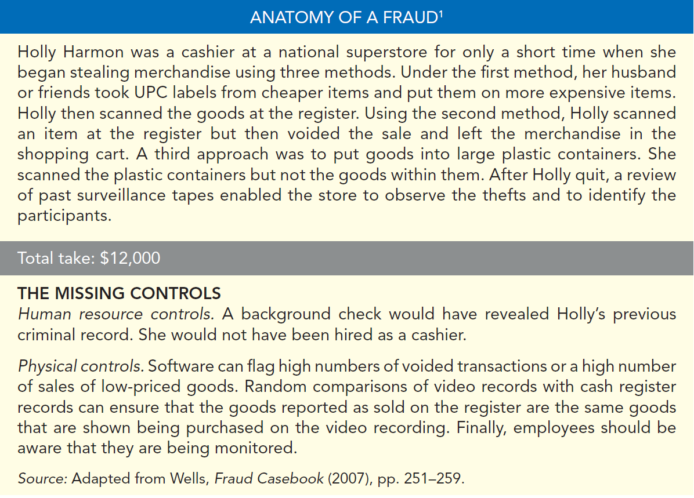
LO 3

Slide 42
SALES RETURNS AND ALLOWANCES
“Flip side” of purchase returns and allowances.
Contra revenue account to Sales Revenue (debit).
Sales not reduced (debited) because:
Would obscure importance of sales returns and allowances as a percentage of sales.
Could distort comparisons.
LO 3

Slide 43
SALES RETURNS AND ALLOWANCES
Illustration: Prepare the entry PW Audio Supply would make to record the credit for returned goods that had a $300 selling price (assume a $140 cost). Assume the goods were not defective (we are taking them back from the customer).
May 8
Sales Returns and Allowances 300
Accounts Receivable 300
8
Inventory 140
Cost of Goods Sold 140
LO 3

Slide 44
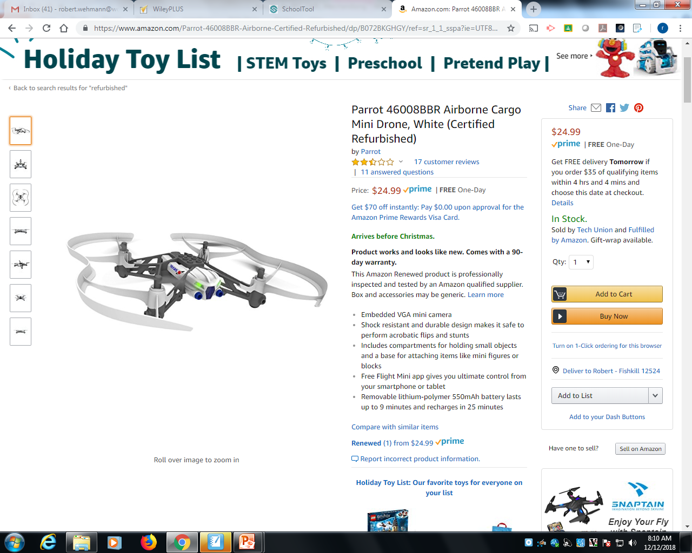
SALES RETURNS AND ALLOWANCES

Slide 45
SALES RETURNS AND ALLOWANCES
Illustration: Assume the returned goods were defective and had a “damaged”/scrap value of $50, PW Audio would make the following entries:
May 8
Sales Returns and Allowances 300
Accounts Receivable 300
8
Inventory 50
Cost of Goods Sold 50
LO 3

Slide 46
SALES RETURNS AND ALLOWANCES
Review Question
The cost of goods sold is determined and recorded each time a sale occurs in:
periodic inventory system only.
a perpetual inventory system only.
both a periodic and perpetual inventory system.
neither a periodic nor perpetual inventory system.
LO 3

Slide 47
ACCOUNTING ACROSS THE ORGANIZATION
The Point of No Returns?
In most industries, sales returns are relatively minor. But returns of consumer electronics can really take a bite out of profits. Recently, the marketing executives at Costco Wholesale Corp. faced a difficult decision. Costco has always prided itself on its generous return policy. Most goods have had an unlimited grace period for returns. A new policy will require that certain electronics must be returned within 90 days of their purchase. The reason? The cost of returned products such as high-definition TVs, computers, and iPods cut an estimated 8¢ per share off Costco’s earnings per share, which was $2.30.
Source: Kris Hudson, “Costco Tightens Policy on Returning Electronics,” Wall Street Journal (February 27, 2007), p. B4.
LO 3

Slide 48
SALES DISCOUNTS
Offered to customers to promote prompt payment of the balance due.
Contra revenue account (debit) to Sales Revenue.
LO 3

Slide 49
SALES DISCOUNTS
Illustration: Assume Sauk Stereo pays the balance due of $3,500 (gross invoice price of $3,800 less purchase returns and allowances of $300) on May 14, the last day of the discount period. Prepare the journal entry PW Audio Supply makes to record the receipt on May 14.
May 14
Cash 3,430
*
Sales Discounts 70
Accounts Receivable 3,500
* [($3,800 – $300) X 2%]
LO 3

Slide 50
DO IT!
3
Sales Transactions
On September 5, De La Hoya Company buys merchandise on account from Junot Diaz Company. The selling price of the goods is $1,500, and the cost to Diaz Company was $800. On September 8, De La Hoya returns goods with a selling price of $200 and a cost of $105. Record the sale on the books of Junot Diaz Company.
SOLUTION
Sept. 5
Accounts Receivable 1,500
Sales Revenue 1,500
Sept. 5
Cost of Goods Sold 800
Inventory 800
LO 3

Slide 51
DO IT!
3
Sales Transactions
On September 5, De La Hoya Company buys merchandise on account from Junot Diaz Company. The selling price of the goods is $1,500, and the cost to Diaz Company was $800. On September 8, De La Hoya returns goods with a selling price of $200 and a cost of $105. Record the return on the books of Junot Diaz Company.
SOLUTION
Sept. 8
Sales Returns and Allowances 200
Accounts Receivable 200
Sept. 8
Inventory 105
Cost of Goods Sold 105
LO 3

Slide 52
Recording Sales of Merchandise
Old E5-5 Presented are transactions related to Wheeler Company.
1. On December 3,Wheeler Company sold $500,000 of merchandise to Hashmi Co., terms 2/10, n/30, FOB shipping point. The cost of the merchandise sold was $350,000.
2. On December 8, Hashmi Co. was granted an allowance of $27,000 for merchandise purchased on December 3.
3. On December 13,Wheeler Company received the balance due from Hashmi Co.
Instructions: Prepare the journal entries to record these transactions on the books of Wheeler Company using a perpetual inventory system.
LO 3 Explain the recording of sales revenues under a perpetual inventory system.

Slide 53
Recording Sales of Merchandise
E5-5 Prepare the journal entries for Wheeler Company .
1. On December 3, Wheeler Company sold $500,000 of merchandise to Hashmi Co., terms 2/10, n/30, FOB shipping point. Cost of merchandise sold was $350,000.
Dec. 3
Accounts receivable 500,000
Sales 500,000
Cost of goods sold 350,000
Merchandise inventory 350,000
LO 3 Explain the recording of sales revenues under a perpetual inventory system.

Slide 54
Recording Sales of Merchandise
E5-5 Continued Prepare the journal entries for Wheeler Company.
2. On December 8, Hashmi Co. was granted an allowance of $27,000 for merchandise purchased on December 3.
Dec. 8
Sales returns and allowances 27,000
Accounts receivable 27,000
LO 3 Explain the recording of sales revenues under a perpetual inventory system.

Slide 55
Recording Sales of Merchandise
E5-5 Continued Prepare the journal entries for Wheeler Company.
2. Variation On Dec. 8, Hashmi Co. returned merchandise for credit of $27,000. The original cost of the merchandise to Wheeler was $19,800.
Dec. 8
Sales returns and allowances 27,000
Accounts receivable 27,000
Merchandise inventory 19,800
Cost of goods sold 19,800
LO 3 Explain the recording of sales revenues under a perpetual inventory system.

Slide 56
Recording Sales of Merchandise
E5-5 Continued Prepare the journal entries for Wheeler Company.
3. On December 13, Wheeler Company received the balance due from Hashmi Co.
Dec. 13
*
Cash 463,540
Sales discounts 9,460
**
Accounts receivable 473,000
***
* ($473,000 – $9,460)
** [($500,000 – $27,000) X 2%]
*** ($500,000 – $27,000)
LO 3 Explain the recording of sales revenues under a perpetual inventory system.

Slide 57
LEARNING OBJECTIVE
4
Prepare a multiple-step income statement and a comprehensive income statement.
SINGLE-STEP INCOME STATEMENT
Subtract total expenses from total revenues
Two reasons for using the single-step format:
Company does not realize any type of profit or income until total revenues exceed total expenses.
Form is simple and easy to read.
LO 4

Slide 58
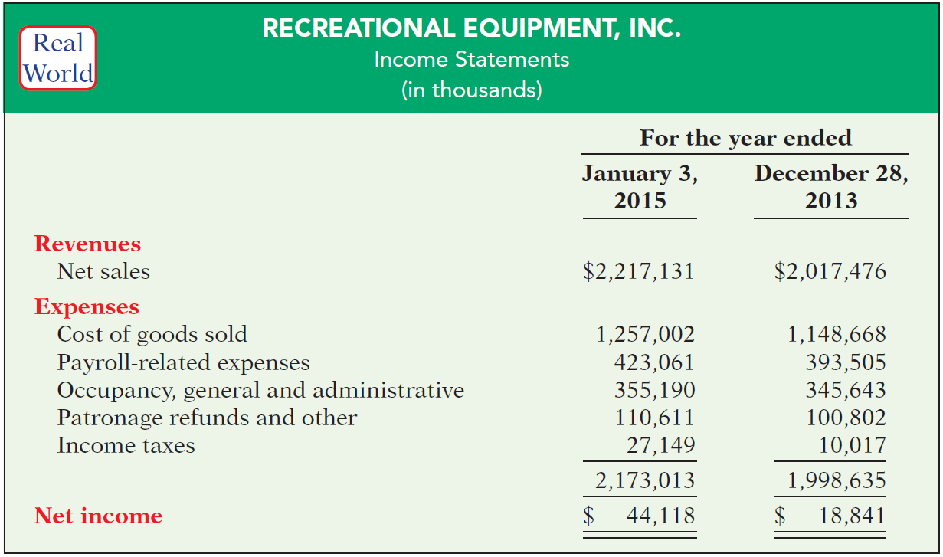
SINGLE-STEP INCOME STATEMENT
Illustration 5-7
ILLUSTRATION 5-7
Single-step income statements
LO 4

Slide 59
MULTIPLE-STEP INCOME STATEMENT
Highlights the components of net income.
Three important line items:
gross profit,
income from operations, and
net income.
LO 4

Slide 60
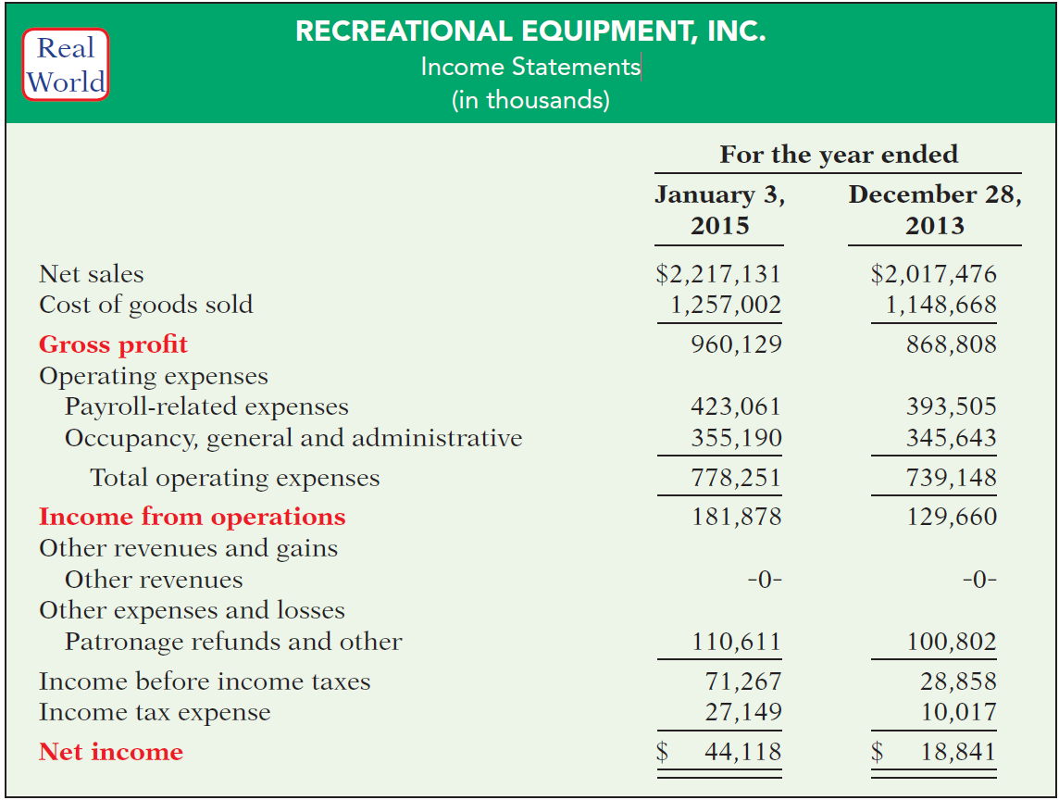
MULTIPLE-STEP INCOME STATEMENT
Key Line Items
ILLUSTRATION 5-8
Multiple-step income statements
LO 4

Slide 61
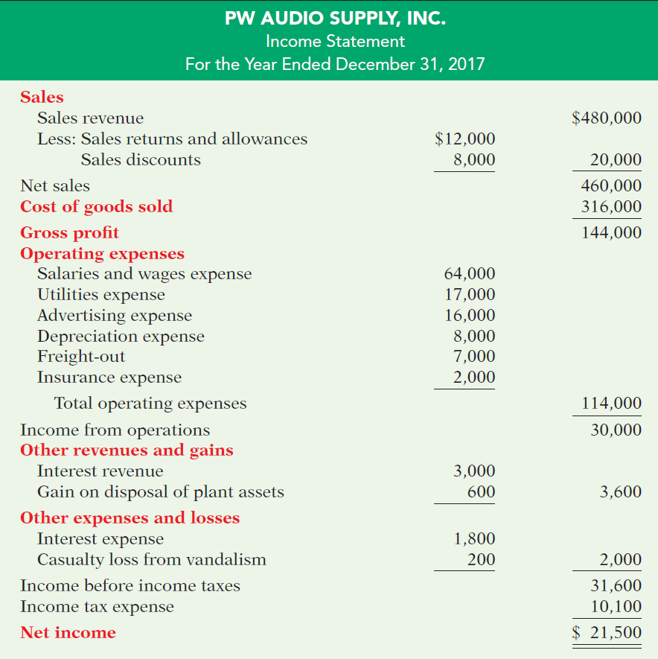
MULTIPLE-STEP
Key Items:
Sales
ILLUSTRATION 5-11
LO 4

Slide 62
MULTIPLE-STEP
Key Items:
Sales
Gross Profit
ILLUSTRATION 5-11
LO 4

Slide 63
MULTIPLE-STEP
Key Items:
Sales
Gross Profit
Operating Expenses
ILLUSTRATION 5-11
LO 4

Slide 64
MULTIPLE-STEP
Key Items:
Sales
Gross Profit
Operating Expenses
Nonoperating Activities
ILLUSTRATION 5-11
LO 4

Slide 65
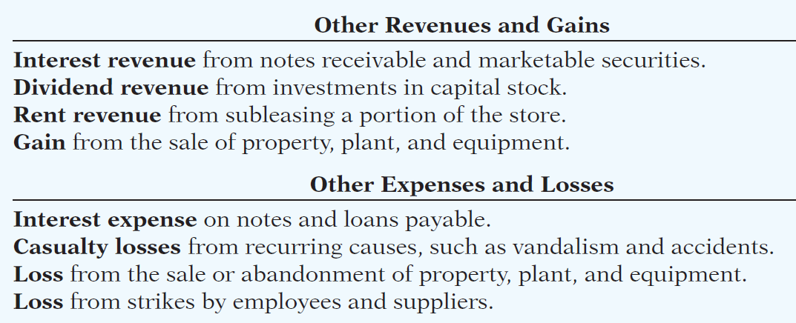
MULTIPLE-STEP
Key Items:
Sales
Gross Profit
Operating Expenses
Nonoperating Activities
ILLUSTRATION 5-11
LO 4

Slide 66
MULTIPLE-STEP
Key Items:
Sales
Gross Profit
Operating Expenses
Nonoperating Activities
Net Income
ILLUSTRATION 5-11
LO 4

Slide 67
MULTIPLE-STEP INCOME STATEMENT
Review Question
The multiple-step income statement for a merchandiser shows each of the following features except:
gross profit.
cost of goods sold.
a sales revenue section.
investing activities section.
LO 4

Slide 68
ETHICS INSIGHT
IBM
Disclosing More Details
After Enron, increased investor criticism and regulator scrutiny forced many companies to improve the clarity of their financial disclosures. For example, IBM began providing more detail regarding its “Other gains and losses.” It had previously included these items in its selling, general, and administrative expenses, with little disclosure. For example, previously if IBM sold off one of its buildings at a gain, it included this gain in the selling, general, and administrative expense line item, thus reducing that expense. This made it appear that the company had done a better job of controlling operating expenses than it actually had. As another example, when eBay recently sold the remainder of its investment in Skype to Microsoft, it reported a gain in “Other revenues and gains” of $1.7 billion. Since eBay’s total income from operations was $2.4 billion, it was very important that the gain from the Skype sale not be buried in operating income.
LO 4

Slide 69
COMPREHENSIVE INCOME STATEMENT
Comprehensive income statement presents items that are not included in the determination of net income.
Items excluded from net income but included in comprehensive income are either reported in a combined statement of net income and comprehensive income, or in a separate comprehensive income statement.
ILLUSTRATION 5-12
Combined statement of net
income and comprehensive
income
LO 4

Slide 70
DO IT!
4
Multiple-Step Income Statement
The following information is available for Art Center Corp. for the year ended December 31, 2017.
Other revenues and gains $ 8,000 Sales revenue $462,000
Other expenses and losses 3,000 Operating expenses 187,000
Cost of goods sold 147,000 Sales discounts 20,000
Other comprehensive
income 10,000
Prepare a multiple-step income statement and comprehensive income statement for Art Center Corp. The company has a tax rate of 25%. This rate also applies to other comprehensive income.
LO 4

Slide 71
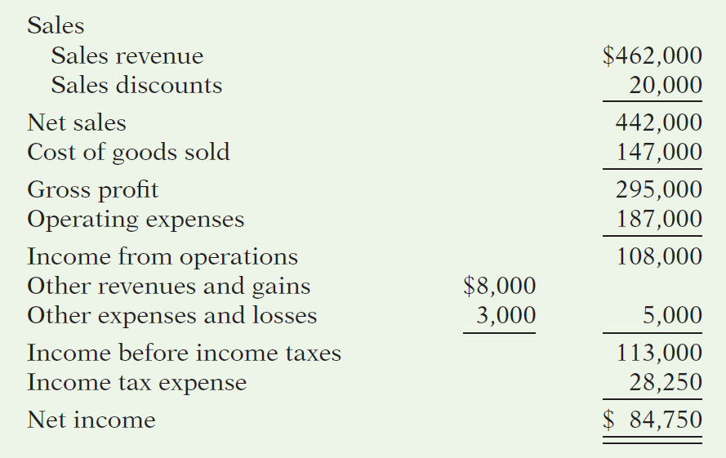
Prepare a multiple-step income statement and comprehensive income statement for Art Center Corp. (statement heading omitted).
LO 4

Slide 72
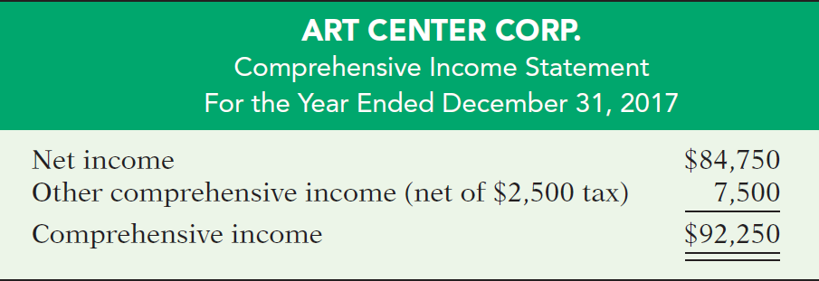
Prepare a multiple-step income statement and comprehensive income statement for Art Center Corp.
LO 4

Slide 73
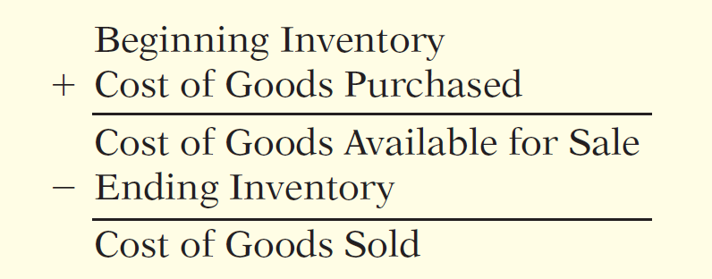
LEARNING OBJECTIVE
5
Determine cost of goods sold under a periodic inventory system.
Periodic Inventory System
No running account of changes in inventory.
Ending inventory determined by physical count.
Cost of goods sold not determined until the end of the period.
ILLUSTRATION 5-13
Basic formula for cost of goods
sold using the periodic system
LO 5

Slide 74
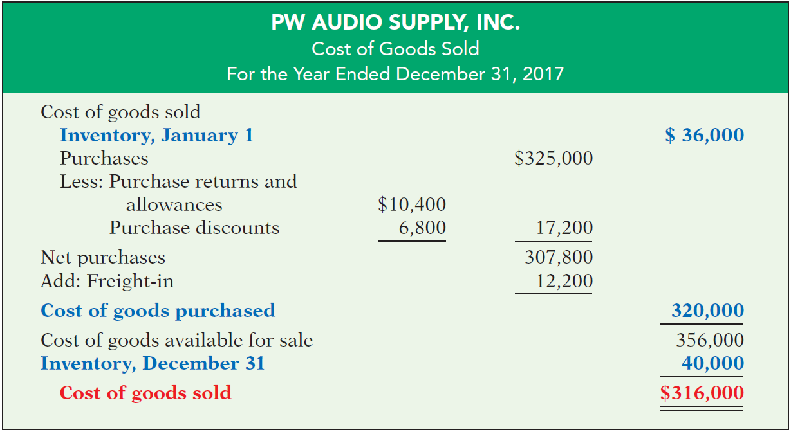
Periodic Inventory System
ILLUSTRATION 5-14
Cost of goods sold for a merchandiser using a periodic inventory system
LO 5

Slide 75
DO IT!
5
COGS—Periodic System
Aerosmith Company’s accounting records show the following at the yearend December 31, 2017.
Purchase Discounts $ 3,400 Freight-In 6,100
Purchases 162,500 Beginning Inventory 18,000
Ending Inventory 20,000 Purchase Returns and Allowances 5,200
Assuming that Aerosmith Company uses the periodic system, compute (a) cost of goods purchased and (b) cost of goods sold.
SOLUTION
Beginning Inventory $ 18,000
Purchases $ 162,500
Purchase Returns and Allowances - 5,200
Purchase Discounts - 3,400
Freight-In + 6,100 160,000 (a)
Goods Available for Sale 178,000
Ending Inventory - 20,000
Cost of Goods Sold $ 158,000 (b)
LO 5

Slide 76
LEARNING OBJECTIVE
6
Compute and analyze gross profit rate and profit margin.
GROSS PROFIT RATE
May be expressed as a percentage by dividing the amount of gross profit by net sales.
A decline in the gross profit rate might have several causes.
Selling products with a lower “markup.”
Increased competition may result in a lower selling price.
Company forced to pay higher prices to its suppliers without being able to pass these costs on to its customers.
LO 6

Slide 77
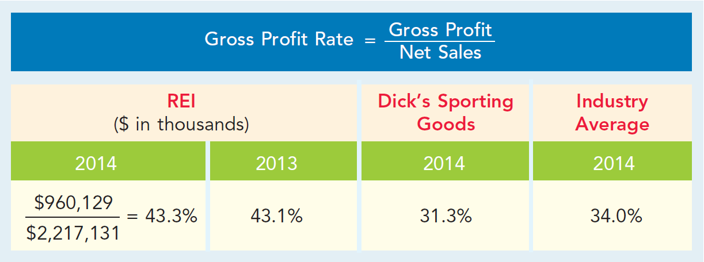
GROSS PROFIT RATE
ILLUSTRATION 5-16
Gross profit rate
Why does REI’s gross profit rate differ so much from that of Dick’s Sporting Goods and the industry average?
LO 6

Slide 78
PROFIT MARGIN
The profit margin measures the percentage of each dollar of sales that results in net income.
How do the gross profit rate and profit margin ratio differ?
Gross profit rate measures the margin by which selling price exceeds cost of goods sold.
Profit margin ratio measures the extent by which selling price covers all expenses (including cost of goods sold).
LO 6

Slide 79
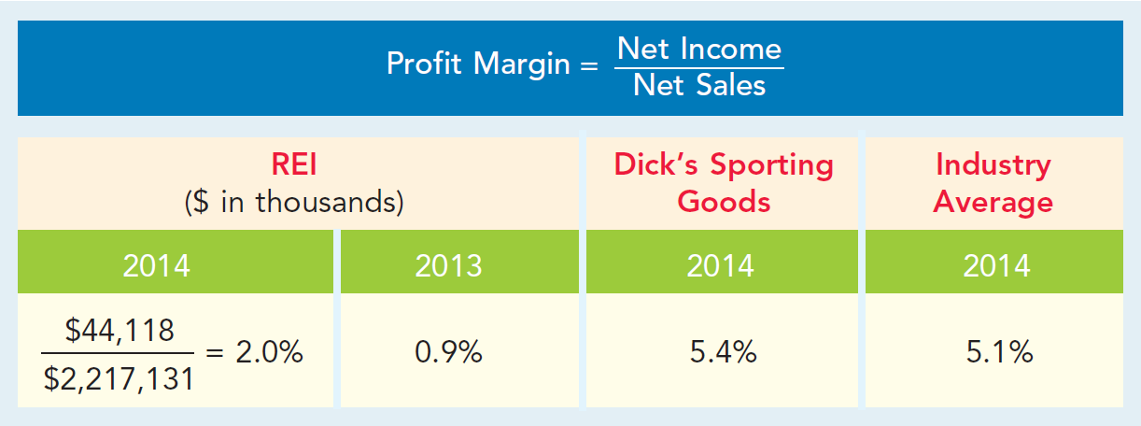
PROFIT MARGIN
ILLUSTRATION 5-18
Profit margin
How does REI compare to its competitors? Its profit margin was lower than Dick’s in 2014 and was less than the industry average. Thus, its profit margin does not suggest exceptional profitability.
LO 6

Slide 80
PEOPLE, PLANET, AND PROFIT INSIGHT
Selling Green
Here is a question an executive of PepsiCo Inc. was asked: Should PepsiCo market green? The executive indicated that the company should, as he believes it’s the No. 1 thing consumers all over the world care about. Here are some of his thoughts on this issue:
“Sun Chips are part of the food business I run. It’s a ’healthy snack.’ We decided that Sun Chips, if it’s a healthy snack, should be made in facilities that have a net-zero footprint. In other words, I want off the electric grid everywhere we make Sun Chips. We did that. Sun Chips should be made in a facility that puts back more water than it uses. It does that. And we partnered with our suppliers and came out with the world’s first compostable chip package.
Now, there was an issue with this package: It was louder than the
(continued)
LO 6

Slide 81
PEOPLE, PLANET, AND PROFIT INSIGHT
Selling Green
New York subway, louder than jet engines taking off. What would a company that’s committed to green do: walk away or stay committed? If your people are passionate, they’re going to fix it for you as long as you stay committed. Six months later, the compostable bag has half the noise of our current package.
So the view today is: we should market green, we should be proud to do it . . . it has to be a 360 process, both internal and external. And if you do that, you can monetize environmental sustainability for the shareholders.”
Source: “Four Problems—and Solutions,” Wall Street Journal (March 7, 2011), p. R2.
LO 6

Slide 82
KEEPING AN EYE ON CASH
Earnings have high quality if they provide a full and transparent depiction of how a company performed.
A measure significantly less than 1 suggests that a company may be using more aggressive accounting techniques in order to accelerate income recognition.
A measure significantly greater than 1 suggests that a company is using conservative accounting techniques which cause it to delay the recognition of income.
LO 6

Slide 83
DO IT!
6
Gross Profit Rate and Profit Margin
Rachel Rose, Inc. reported the following in its 2017 and 2016 income statements.
2017 2016
Net sales $80,000 $120,000
Cost of goods sold 40,000 60,000
Operating expenses 14,000 28,000
Income tax expense 8,000 12,000
Net income $18,000 $ 20,000
Determine the company’s gross profit rate and profit margin.
2017
2016
($80,000 − $40,000)
($120,000 − $60,000)
= 50%
= 50%
$80,000
$120,000
LO 6

Slide 84
DO IT!
6
Gross Profit Rate and Profit Margin
Rachel Rose, Inc. reported the following in its 2017 and 2016 income statements.
2017 2016
Net sales $80,000 $120,000
Cost of goods sold 40,000 60,000
Operating expenses 14,000 28,000
Income tax expense 8,000 12,000
Net income $18,000 $ 20,000
Determine the company’s gross profit rate and profit margin.
2017
2016
$18,000 ÷ $80,000 = 22.5%
$20,000 ÷ $120,000 = 16.7%
LO 6

Slide 85
LEARNING OBJECTIVE
*7
APPENDIX 5A: Record purchases and sales of inventory under a periodic inventory system.
RECORDING MERCHANDISE TRANSACTIONS
Record revenues when sales are made.
Do not record cost of merchandise sold on the date of sale.
Physical inventory count determines:
Cost of merchandise on hand and
Cost of merchandise sold during the period.
Record purchases in Purchases account.
Purchase returns and allowances, Purchase discounts, and Freight costs are recorded in separate accounts.
LO 7

Slide 86
RECORDING PURCHASE OF MERCHANDISE
Illustration: On the basis of the sales invoice (Illustration 5-5) and receipt of the merchandise ordered from PW Audio Supply, Sauk Stereo records the $3,800 purchase as follows.
May 4
Purchases 3,800
Accounts Payable 3,800
LO 7

Slide 87
FREIGHT COSTS
Illustration: If Sauk pays Public Freight Company $150
for freight charges on its purchase from PW Audio Supply on May 6, the entry on Sauk’s books is:
May 6
Freight-in (Transportation-in) 150
Cash 150
LO 7

Slide 88
Purchase Returns and Allowances
Illustration: Sauk Stereo returns $300 of goods to PW Audio Supply and prepares the following entry to recognize the return.
May 8
Accounts Payable 300
Purchase Returns and Allowances 300
LO 7

Slide 89
Purchase Discounts
Illustration: On May 14 Sauk Stereo pays the balance due on account to PW Audio Supply, taking the 2% cash discount allowed by PW Audio for payment within 10 days. Sauk Stereo records the payment and discount as follows.
May 14
Accounts Payable 3,500
Purchase Discounts 70
Cash 3,430
LO 7

Slide 90
RECORDING SALES OF MERCHANDISE
Illustration: PW Audio Supply, records the sale of $3,800 of merchandise to Sauk Stereo on May 4 (sales invoice No. 731, Illustration 5-5) as follows.
May 4
Accounts Receivable 3,800
Sales Revenue 3,800
No entry is recorded for cost of goods sold at the time of the sale under a periodic system.
LO 7

Slide 91
Sales Returns and Allowances
Illustration: To record the returned goods received from Sauk Stereo on May 8, PW Audio Supply records the $300 sales return as follows.
May 8
Sales Returns and Allowances 300
Accounts Receivable 300
LO 7

Slide 92
Sales Discounts
Illustration: On May 14, PW Audio Supply receives payment of $3,430 on account from Sauk Stereo. PW Audio honors the 2% cash discount and records the payment of Sauk’s account receivable in full as follows.
May 14
Cash 3,430
Sales Discounts 70
Accounts Receivable 3,500
LO 7

Slide 93
COMPARISON OF ENTRIES—PERPETUAL VS. PERIODIC
LO 7

Slide 94
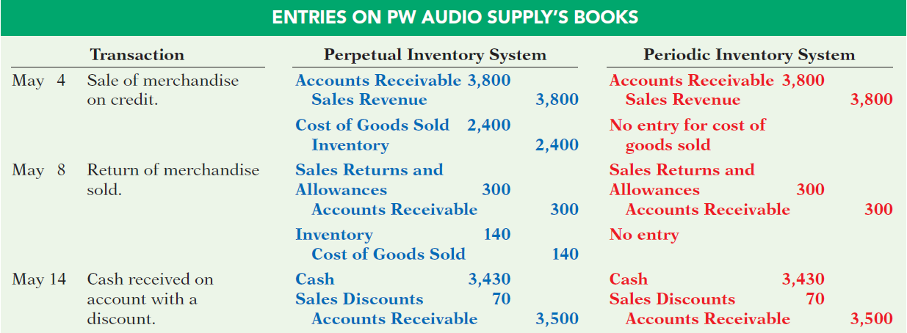
COMPARISON OF ENTRIES—PERPETUAL VS. PERIODIC
LO 7

Slide 95
A Look at IFRS
Compare the accounting for merchandising under GAAP and IFRS.
LEARNING OBJECTIVE
8
KEY POINTS
Similarities
Under both GAAP and IFRS, a company can choose to use either a perpetual or a periodic inventory system.
The definition of inventories is basically the same under GAAP and IFRS.
LO 8

Slide 96
A Look at IFRS
KEY POINTS
Similarities
As indicated above, the basic accounting entries for merchandising are the same under both GAAP and IFRS.
Both GAAP and IFRS require that income statement information be presented for multiple years. For example, IFRS requires that 2 years of income statement information be presented, whereas GAAP requires 3 years.
LO 8

Slide 97
A Look at IFRS
KEY POINTS
Differences
Under GAAP, companies generally classify income statement items by function. Classification by function leads to descriptions like administration, distribution, and manufacturing. Under IFRS, companies must classify expenses either by nature or by function. Classification by nature leads to descriptions such as the following: salaries, depreciation expense, and utilities expense. If a company uses the functional-expense method on the income statement, disclosure by nature is required in the notes to the financial statements.
LO 8

Slide 98
A Look at IFRS
KEY POINTS
Differences
Presentation of the income statement under GAAP follows either a single-step or multiple-step format. IFRS does not mention a single-step or multiple-step approach.
Under IFRS, revaluation of land, buildings, and intangible assets is permitted. The initial gains and losses resulting from this revaluation are reported as adjustments to equity, often referred to as other comprehensive income. The effect of this difference is that the use of IFRS result in more transactions affecting equity (other comprehensive income) but not net income.
LO 8

Slide 99
A Look at IFRS
LOOKING TO THE FUTURE
The IASB and FASB are working on a project that would rework the structure of financial statements. A main goal of this new approach is to provide information that better represents how businesses are run. This approach draws attention away from just one number—net income. It will adopt major groupings similar to those currently used by the statement of cash flows (operating, investing, and financing), so that numbers can be more readily traced across statements. For example, the amount of income that is generated by operations would be traceable to the assets and liabilities used to generate the income. Finally, this approach would also provide detail, beyond that currently seen in most statements (either GAAP or IFRS), by requiring that line items be presented both by function and by nature.
LO 8

Slide 100
A Look at IFRS
IFRS Practice
Which of the following would not be included in the definition of inventory under IFRS?
Photocopy paper held for sale by an office-supply store.
Stereo equipment held for sale by an electronics store.
Used office equipment held for sale by the human relations department of a plastics company.
All of the above would meet the definition.
LO 8

Slide 101
A Look at IFRS
IFRS Practice
Which of the following would not be a line item of a company reporting costs by nature?
Depreciation expense.
Salaries expense.
Interest expense.
Manufacturing expense.
LO 8

Slide 102
A Look at IFRS
IFRS Practice
Which of the following would not be a line item of a company reporting costs by function?
Administration.
Manufacturing.
Utilities expense.
Distribution.
LO 8

Slide 103
COPYRIGHT
“Copyright © 2016 John Wiley & Sons, Inc. All rights reserved. Reproduction or translation of this work beyond that permitted in Section 117 of the 1976 United States Copyright Act without the express written permission of the copyright owner is unlawful. Request for further information should be addressed to the Permissions Department, John Wiley & Sons, Inc. The purchaser may make back-up copies for his/her own use only and not for distribution or resale. The Publisher assumes no responsibility for errors, omissions, or damages, caused by the use of these programs or from the use of the information contained herein.”

