Slide 1
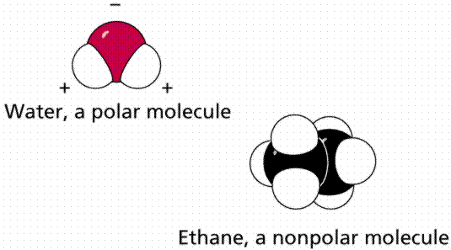
Topic: Polarity in Covalent Bonds
Do Now: What is the difference between a polar molecule and nonpolar molecule?

Slide 2
How do you tell Polar from Nonpolar??
From the IMF unit we learned….
If it’s dispersion (diatomic, noble gas, pure hydrocarbon, small symmetrical) it’s nonpolar
If it’s not it’s polar

Slide 3
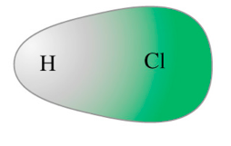
Polar Bond (Asymmetric)
Polar – has poles
Meaning ends are different
Polar bond: one end more electrons than other end
So there is a Large difference in electronegativity

Slide 4
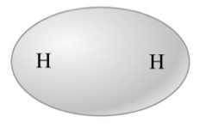
Nonpolar Bond (symmetric)
Nonpolar = No poles
electron cloud on one end of bond same as other end
Same to no difference in electronegativity

Slide 5
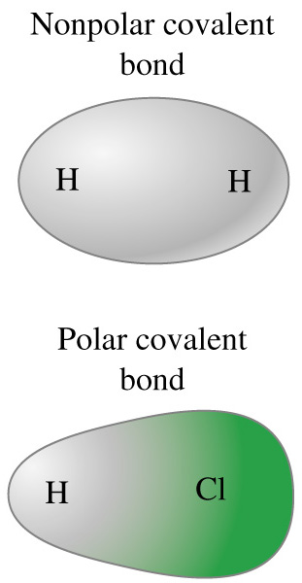
H₂ is symmetric. Both ends are the same. The electron cloud is football-shaped.
HCl is asymmetric. The electron cloud is lop-sided. Chlorine has more than its fair share.

Slide 6
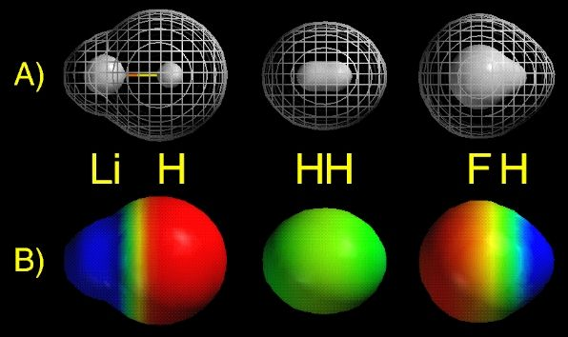
Which bond(s) are polar?
Which are nonpolar?
Polar = LiH and HF. Nonpolar = H₂
Red = electron rich.
Blue = electron poor.

Slide 7
How can you predict if a bond is Polar or Nonpolar if you don’t have a picture of the electron cloud??
Compare the electronegativities (subtract the difference) of the two atoms in the bond.
Nonpolar Covalent 0-0.5
Ionic 1.7-4.0
0
0.5
1.7
4
Polar Covalent 0.5-1.7

Slide 8
Electronegativity
Ability of an atom to attract electrons in a bond.
Memory Jogger
Look it up in Table S!

Slide 9
Bond Polarity
Depends on the difference in electronegativity of the two atoms in the bond.
A B
⏐ ⏐
E_{A} - E_{B}
Bond
Polarity
-You only care about the size of the difference, not the sign.
-The bigger the difference, the more polar the bond.

Slide 10
Electronegativity Difference
Electronegativity Difference | Type of Bond
0.0 to 0.5 | Nonpolar Covalent
0.6 to 1.7 | Polar Covalent
> 1.7 | Ionic

Slide 11
Nonpolar Covalent 0-0.5
Ionic 1.7-4.0
0
0.5
1.7
4
Polar Covalent 0.5-1.7
Most Ionic Character
(greatest difference)
Most Covalent Character
(smallest difference)
Most Ionic Character

Slide 12
Predict the Polarity & Bond Type
N₂
NaCl
HCl
O₂
LiBr
HI
HBr
3.0 – 3.0 = 0, Nonpolar Covalent
3.2 – 0.9 = 2.3, Ionic
3.2 – 2.1 = 1.1, Polar Covalent
3.4 – 3.4 = 0, Nonpolar Covalent
3.0 – 1.0 = 2.0, Ionic
2.7 – 2.1 = 0.6, Polar Covalent
3.0 – 2.1 = 0.9, Polar Covalent

Slide 13
Review
Which of the following bonds is the most polar?
A) O₂
B) HCl
C) NH in NH₃
D) HBr
3.4 – 3.4 = 0
3.2 – 2.1 = 1.1
3.0 – 2.1 = 0.9
3.0 – 2.1 = 0.9
Answer = (B) HCl

Slide 14
Review
Which substance contains a bond with the greatest ionic character?
A) KCl
B) HCl
C) Cl₂
D) CCl₄
3.2 – 0.8 = 2.4
3.2 – 2.1 = 1.1
3.2 – 3.2 = 0
3.2 – 2.6 = 0.6
Answer = (A) KCl

Slide 15
Summary
Nonpolar covalent bonds form between atoms having equal or close electronegativity values. (Difference is < to 0.5.)
Polar covalent bonds form between atoms with an electronegativity difference between 0.5 and 1.7.
Ionic bonds form between atoms with an electronegativity difference > 1.7.
_

