Slide 1
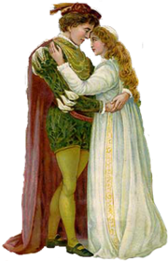
Romeo and Juliet by William Shakespeare
Act 2 Scenes 3 - 6
By Erin Salona

Slide 2
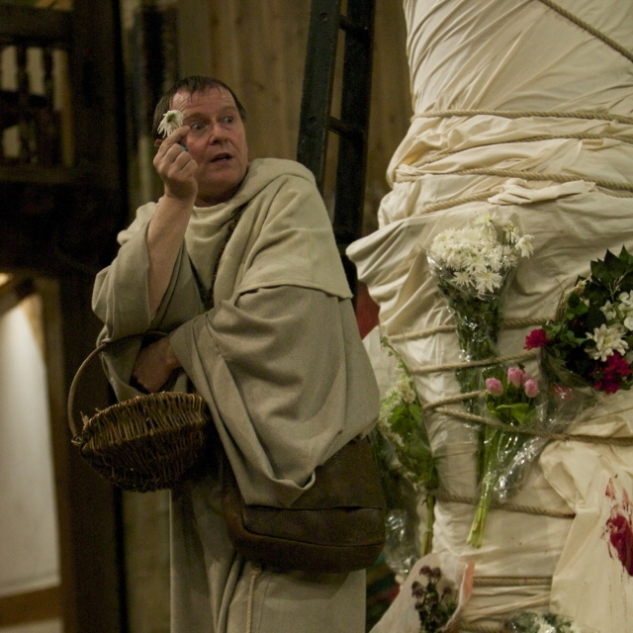
Act 2, Scene 3
Romeo goes to visit Friar Lawrence
Friar Laurence is alone in his garden tending to plants and herbs
He says that nothing is completely good or evil. It is how it is used.
His monologue hints at his involvement in the tragedy to come.
The audience is now aware that Friar has a strong understanding of drugs. FORESHADOWING

Slide 3
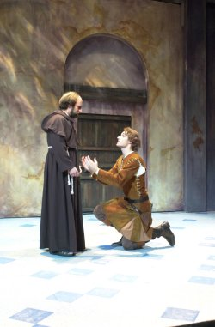
Act 2, Scene 3
Romeo explains to Friar:
he no longer loves Rosaline and
he is now in love with Juliet
  Romeo: Then plainly know my heart's dear love is set
  On the fair daughter of rich Capulet:
  As mine on hers, so hers is set on mine;
he asks Friar Laurence to marry them today!

Slide 4
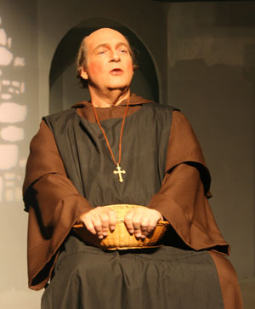
Act 2, Scene 3
Friar Lawrence is shocked! He tells Romeo:
that Romeo says the words of love
but he really doesn’t really understand true love.
Friar Lawrence: Holy Saint Francis, what a change is here!
Is Rosaline, whom thou didst love so dear,
So soon forsaken? young men's love then lies
Not truly in their hearts, but in their eyes.

Slide 5
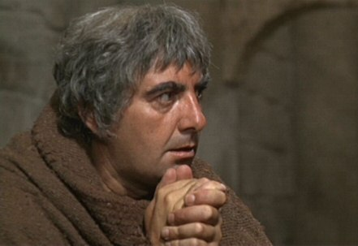
Act 2, Scene 3
Friar Laurence isn’t sure this marriage is a good idea but
he agrees to marry them
because he thinks it will stop the feud between the two families.
Friar Laurence: In one respect I'll thy assistant be;
For this alliance may so happy prove,
To turn your households' rancour to pure love.

Slide 6
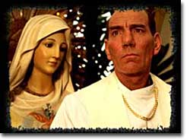
Act 2, Scene 3
Friar Lawrence gives Romeo good advice:
“Wisely and slow; they stumble that run fast.”

Slide 7
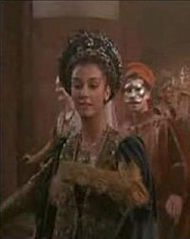
Act 2, Scene 4
The morning after the Capulet party, Benvolio & Mercutio search for Romeo.
Mercutio blames Romeo’s absence on Rosaline.
They still don’t know about Juliet.
Rosaline

Slide 8
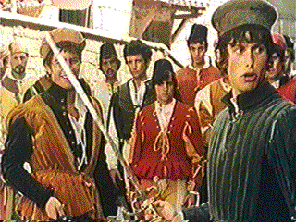
Act 2, Scene 4
Tybalt has sent a letter to Romeo challenging him to a duel.
Benvolio believes Romeo will respond.
Tybalt can’t imagine Romeo, the romantic, fighting the fiery Tybalt.

Slide 9

Act 2, Scene 4
Benvolio & Mercutio discuss how Tybalt is an expert at dueling
Tybalt is still upset because Romeo was at the Capulet party.
Tybalt looks for fights; he is a hothead

Slide 10
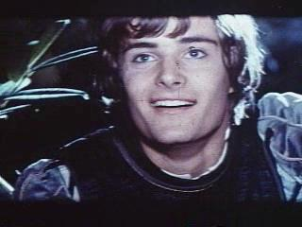
Act 2, Scene 4
After arranging the secret marriage, Romeo meets them and he is in a much better mood.
Mercutio is happy that Romeo is over Rosaline.
Romeo and Mercutio trade a long series of puns.
Happy Romeo

Slide 11
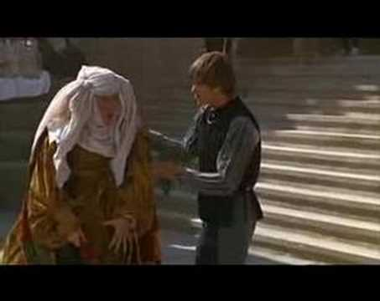
Act 2, Scene 4
Nurse comes and finds Romeo at noon and not 9:00 am as promised.
Mercutio teases the nurse & upsets her.
Mercutio lifts her veil and calls it a sail; he refers to her as a madam of a prostitution house; he makes fun of her age and of her lack of beauty
Nurse & Romeo

Slide 12

Act 2, Scene 4
Romeo tells the nurse about the plan for the wedding.
Juliet is to go to confession at Friar Laurence’s room that afternoon.
They will be married there.
Romeo’s servant will give a rope ladder to the Nurse.
Romeo will use it to climb into Juliet’s room for their wedding night.

Slide 13
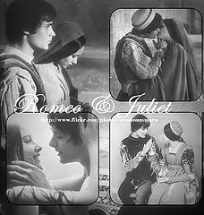
Act 2, Scene 4
Nurse tells Romeo that
she thinks that Paris would make a Juliet better husband.
Juliet doesn’t agree with her.

Slide 14
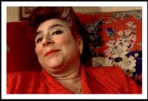
Act 2, Scene 5
Juliet is very nervous as she waits for Nurse to return from meeting Romeo.
Nurse is 3 hours late.
Nurse teases Juliet by not giving her Romeo’s message immediately.
The Nurse shows herself to be like Mercutio when she describes Romeo’s physical attributes as Mercutio had described Rosaline’s.

Slide 15

Act 2, Scene 5
Juliet prepares to go to Friar Laurence to get married.
Juliet will tell her parents she is going to “shrift”/ confession.
Nurse leaves to collect the rope ladder so that Romeo can spend his wedding night with Juliet.

Slide 16
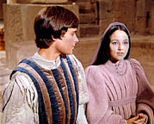
Act 2, Scene 6
Before Juliet arrives Romeo and Friar Laurence talk.
Friar Laurence prays that God will bless the wedding regardless of what else might happen to the couple, and
warns that “things” that happen so fast often end just as quickly (and explosively). FORESHADOWING
Friar Laurence: These violent delights have violent ends
And in their triumph die, like fire and powder. . .
Therefore love moderately; long love doth so;
Too swift arrives as tardy as too slow.

Slide 17
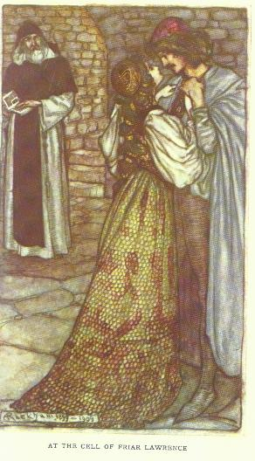
Act 2, Scene 6
When Juliet arrives, Romeo uses many poetic words to describe her and their love.
Romeo believes that not even death can compete with his love for Juliet
They secretly marry.

Slide 18
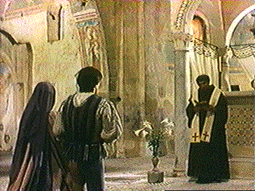
Act 2, Scene 6
Their wedding is quick and is filled with images of impending doom.
Images of happiness and marriage are paired with violence and death.
Romeo says “love-devouring death” can do what it pleases; Juliet is all he needs to make him happy

Slide 19

Act 2, Scene 6
These violent delights have violent ends
And in their triumph die, like fire and powder,
Which as they kiss consume: the sweetest honey
Is loathsome in his own deliciousness
And in the taste confounds the appetite:
Therefore love moderately; long love doth so;
Too swift arrives as tardy as too slow.

Slide 20
Works Cited
Chichester, Karen. “Romeo and Juliet Outlines by
Act.” Jefferson High School: Livonia, Michigan.
SlideShare.net. SlideShare Inc. Sept. 2008. Web.
18 May 2010.
“Romeo and Juliet.” Google Images. Google. 2010. Web. 18
May 2010.
Shakespeare, William. Romeo and Juliet. The Complete
Works of William Shakespeare. Michigan Institute
of Technology. 2010. Web. 18 May 2010.

