Slide 1
The Articles of Confederation 1781-1789

Slide 2
The Articles of Confederation
What: The 1st US Constitution
When: 1781-1789
How They Worked:
One Branch-Legislative-Congress
Each State had one vote, 9-13 to pass a law, all 13 to change a law
Weaknesses:
No Executive to carry out laws
No Judicial to interpret, settle disputes state vs. state

Slide 3
The Articles of Confederation
CONGRESS HAD NO POWER TO TAX! $75Mdebt,
States could print their own $$,
States taxed each others trade/commerce
States had more power than National Gov’t.
This was done intentionally to prevent a strong national/central gov’t, which the leaders feared due to their experience w/Br.
A loss of states rights was the main concern.

Slide 4
The Articles of Confederation
Positives:
Negotiated the Treaty of Paris that ended the War for Independence.
Created an orderly way of bringing new states into the union-Land Ordinances.
Ultimately too many weaknesses, Shay’s Rebellion proved a change was needed.

Slide 5
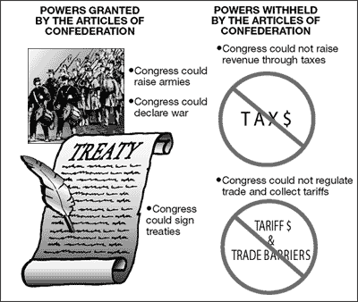

Slide 6
