Slide 1
Electrostatics

Slide 2
Electrostatics
Electrostatics is the study of electrical charges at rest; i.e., charged objects that are stationary or in a fixed position.

Slide 3
Charged and Uncharged Objects
Neutral Object: An object that has neither an excess nor a deficiency of electrons.
# of electrons = # of protons
Charged Object: An object with an excess or deficiency of electrons.
+
-
+
Positive
-
Negative
-
+

Slide 4
Positively and Negatively Charged Objects
Why is the type of charge in reference to electrons and not protons.
Because electrons exist outside the positive nucleus and can be readily transferred from one object to another.
What happens if you start moving protons?
You change the element.

Slide 5
Elementary Charge (e) / Fundamental Charge
What is the charge of an electron?
-1.6 x 10⁻¹⁹ Coulombs (C)
What is the charge of a proton?
+1.6 x 10⁻¹⁹ Coulombs (C)
The magnitude of the charge of the electron is equal and opposite that of the proton.
The unit of charge is the Coulomb (C).
Note: In physics, the charge of an electron is NOT +1 or –1!

Slide 6
Example #1
An object has three excess electrons.
What is its “fundamental charge”?
What is its charge in coulombs?
-3 fundamental (or elementary) charges
q = 3e x (-1.6 x 10⁻¹⁹ C/e) = -4.8 x 10⁻¹⁹ C
“fundamental charge” = elementary charge (e)
“q” is the variable letter used for CHARGE

Slide 7
Example #2
An object has 75 protons and 65 electrons
What is its “fundamental charge”?
What is its charge in coulombs?
+10 fundamental charges
q = 10e x (+1.6 x 10⁻¹⁹ C/e) = +1.6 x 10⁻¹⁸ C
Note: You CANNOT have fractions of the elementary charge, e.g. ½ of e or 0.8 x 10⁻¹⁹C

Slide 8
Law of Conservation of Charge
The total amount of charge in a closed system remains constant – charge is not created or destroyed, it only moves from one object to another
Charge “moves” as a result of ELECTRON movement ONLY!!!

Slide 9
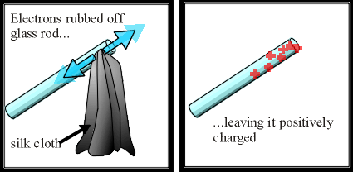
Rubber and Wool/Glass and Silk
Rubbing a rubber rod with a piece of wool: The rod will pull the electrons off the wool, so that the rubber rod will end up with a net negative charge and the wool will have a net positive charge.
Rubbing a glass rod with a piece of silk: The silk will pull the electrons off the glass, so that the glass rod will end up with a net positive charge and the silk will have a net negative charge.

Slide 10
Conductors and Insulators
Conductors: Materials that allow for the free flow of electrons.
The best conductors come from the transitional elements of the periodic table.
The characteristics of the d orbitals permit electrons to flow freely because at least one electron is not held tightly by the nucleus.
Insulators: Materials that do not allow electrons to flow freely.

Slide 11
Forces of Attraction and Repulsion
In nature there are three principal forces – gravity, electromagnetic and nuclear (strong & weak).
Attractive Forces: Opposite charges attract one another. A positively charged object will be attracted to a negatively charged object and vice versa.
Repulsive Forces: Like charges repel. Two positively charged objects or two negatively charged objects in proximity to one another will experience a repulsive force.
+
-
-
+
-
+
Two Neutral Spheres
Notes:
Do demonstration with ruler and watch glass.

Slide 12
How do Objects Become Charged?
Conduction: Through direct contact.
Friction: Separation of Charge.
Induction: Without direct contact.

Slide 13
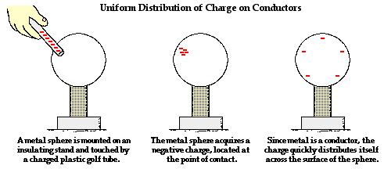
Charge by Conduction
Electrons flow from a charged object to an uncharged object through contact.

Slide 14
Charge Distribution on Conductors and Insulators
Conductors: Excess charges will maximize the space between them, which means that they will reside on the surface of the object with a uniform distribution.
Insulators: Excess charges will be located largely where they were transferred to the material.

Slide 15
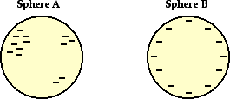
Ex. #3 Charge Distribution
One of these isolated charged spheres is copper and the other is rubber. The diagram below depicts the distribution of - charge over the surface of two spheres. Which one is rubber and which one is copper?
Rubber
Copper

Slide 16
Example #4
Two charge spheres are brought into contact with one another and then separated. One of the spheres has a charge of -5 C while the other has a charge of +8 C prior to them being brought into contact with one another.
What is the total charge of the system?
What is the charge on each of the spheres afterwards?
How many elementary charges would have to be added or subtracted from each sphere to make them neutral?
+
_
_
_
_
+
+
_
+
_
+
+
+
_
+
+
_
+
_
+
+
+
+
+
_
_
+
+
+
_
+
+
_
_
+
+
_

Slide 17
Example 4, cont.:
Applying the law of conservation of charge, the total charge of the system of charges must remain constant.
+8 C + -5 C = 3 C
Since there are only two spheres, the charge will be equally distributed over the surface of the two spheres. Consequently, each sphere will have +1.5 C of charge.
_
_
_
_
_
_
_
_
_
_
_
+
_
+
+
+
+
+
+
+
+
_
+
+
+
_
_
+
_
_
+
+
_
_
+
+
_
+
_
+
+
+
+
+
+
_
+
+
_
+
_
_
+
_
+
_
_
+
+
+
+
+
+
+
+
+
_
+
+
_
+
+
+
+
+
_
+
+
+
_
_
+
+
_
+
+
_
+
_
+
+
+
+
_
+
+
_
_
_
_
_
+
+
+
_
+
_
+
_
+
+
+
+
_
+
+
+
+
+

Slide 18
Example 3, cont.:
There are two ways of finding the number of elementary charges that would have to be added or subtracted from each sphere.
or

Slide 19
Separation of Charge
When two neutral bodies are rubbed together, they can become charged through friction.
As per Conservation of Charge, one body will become positively charged while the other body will become negatively charged.
Electrons will be pulled from one object and deposited on the other.
When a charged body is brought in close proximity to one that is neutral, the neutral one will develop an imbalance in charge distribution.
-
+
-
+
+
-
-
-
+
+
- - - - - - - -
❘
+
+
-
-
-
+
-
+

Slide 20
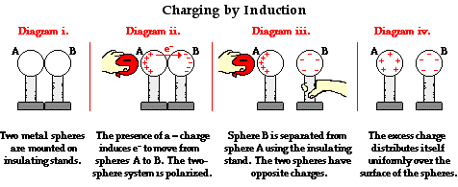
Charge by Induction
Electrons flow from one sphere to the other due to separation of charge.

Slide 21
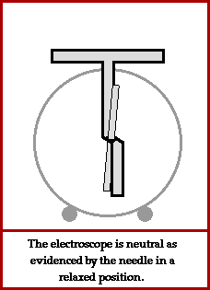
Charge by Induction of an Electroscope

Slide 22
Key Ideas
Objects become charged by losing or gaining electrons.
Negatively charged objects have an excess of electrons.
Positively charged objects have a deficiency of electrons.
Like charges repel.
Unlike charges attract.
Conductors allow electrons to flow freely.
Insulators do not allow electrons to flow easily.
Separation of charge occurs when objects become charged or when a charged object is brought in local proximity to an uncharged (neutral) object.

Slide 23
Key Ideas
Charge by conduction results when charge is transferred through contact.
Charge by induction occurs when a charged object is place in local proximity to a neutral object causing a separation of charge.

Slide 24
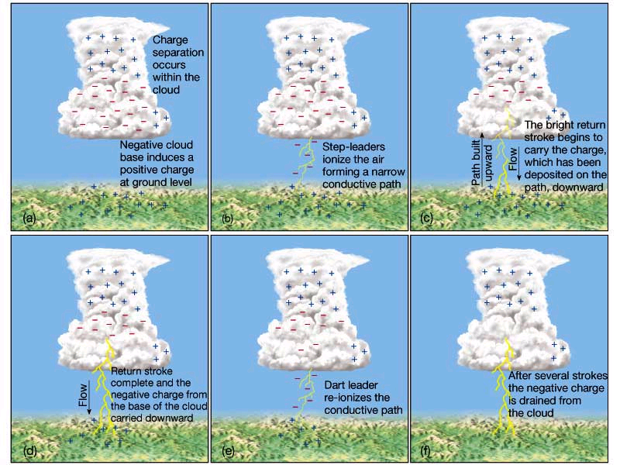
Separation of Charge and Lightning
Lightning
Lightning

Slide 25
Forces of Attraction and Repulsion
In nature there are three principal forces – gravity, electromagnetic and nuclear (strong & weak).
Electromagnetic:
Attractive Forces: Opposite charges attract one another. A positively charged object will be attracted to a negatively charged object and vice versa.
Repulsive Forces: Like charges repel. Two positively charged objects or two negatively charged objects in proximity to one another will experience a repulsive force.
+
Notes:
Do demonstration with ruler and watch glass.

