Slide 1
Plot structure, Conflict, and theme

Slide 2
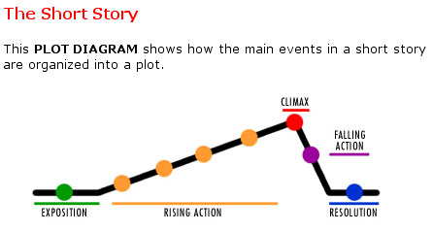
Plot structure
  Plot is the literary element that describes the structure of the story.
  Plot shows the causal arrangement of events and actions within a story.

Slide 3
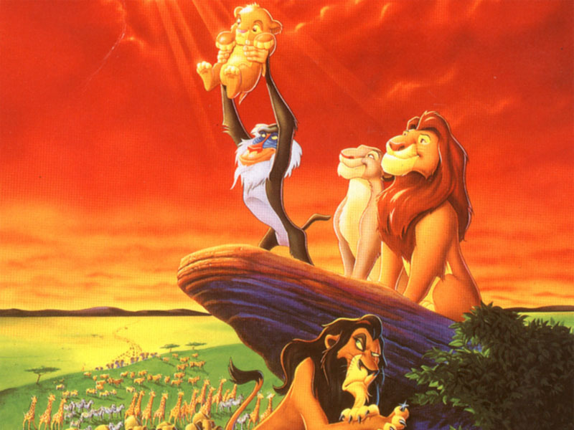
Plot structure: Exposition
  Sets the scene
  Author introduces the setting and characters
  Provides description and background information
Example

Slide 4
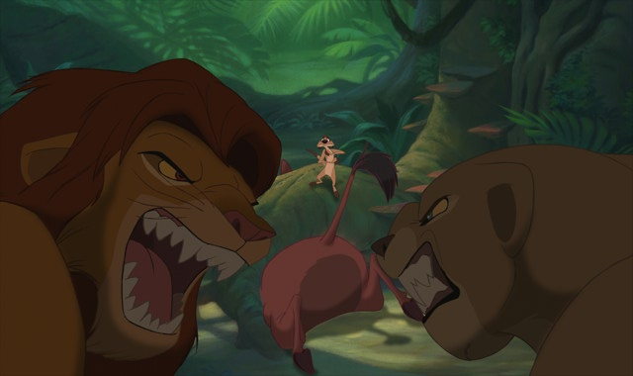
Plot structure: Rising action
  Series of conflicts and crises in the story that lead to the turning point
Example

Slide 5
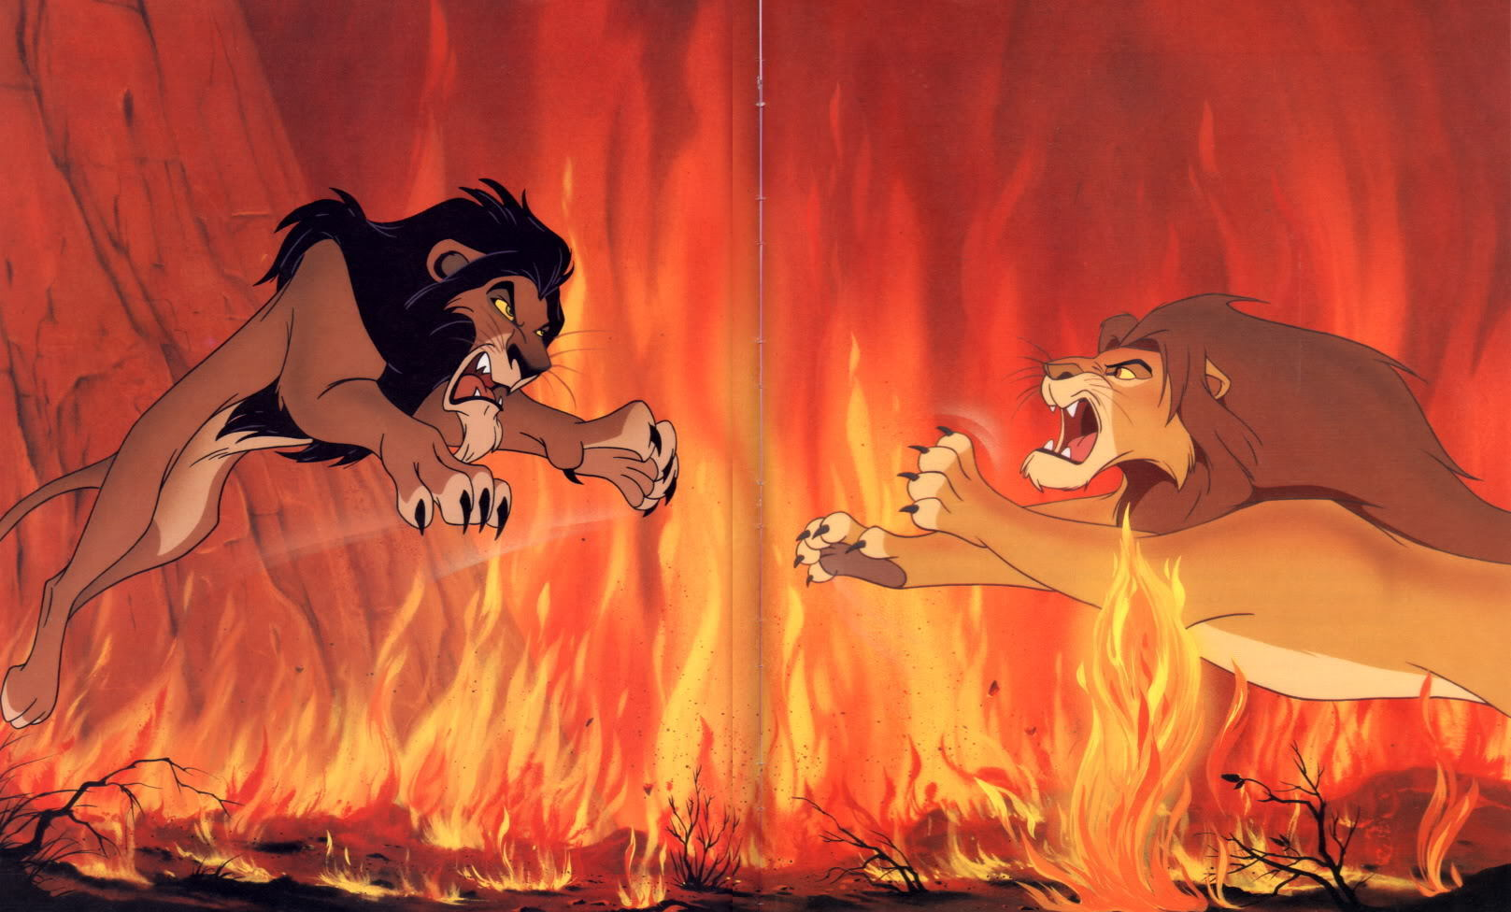
Plot structure: climax
  Also called the “turning point”
  Event that the rising action and central conflict leads up to
  Place where plot turns or “changes direction” toward a resolution
Example

Slide 6
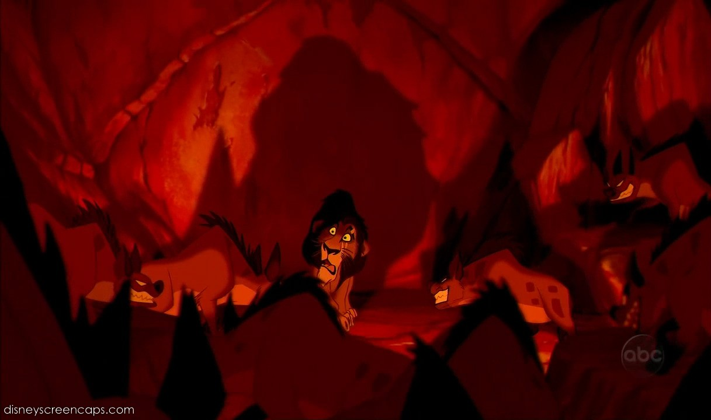
Plot structure: falling action
  Events that happen as a result of the climax as the conflict grows closer to being resolved
Example

Slide 7
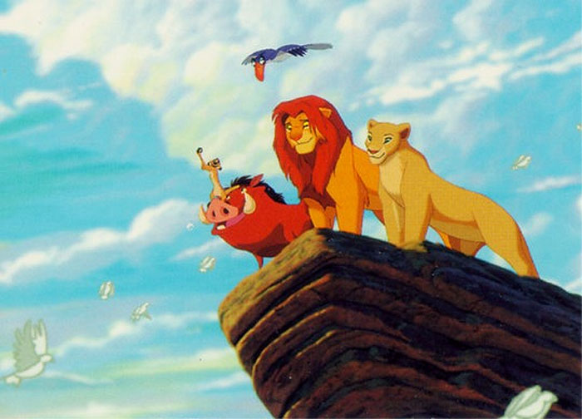
Plot structure: resolution
  Main conflict is solved or resolved
Example

Slide 8
conflict
  Without conflict, there is no plot!
  Usually introduced during the rising action
  Faced head-on during the climax
  Begins to work itself out during the falling action
  Is resolved during the resolution

Slide 9
conflict
Internal
  Character vs Him- or Herself
    Struggle takes place in character’s own mind
    Usually something to do with choice or overcoming emotions or mixed feelings
External
  Character vs Character
    Protagonist vs antagonist
  Character vs Nature
    Usually character is struggling to survive
  Character vs Society
    Group of characters fighting against society
    Character fights against social traditions or rules

Slide 10
Other types of conflict
  Character vs Supernatural
    Gods, ghosts, monsters, spirits, aliens, etc.
  Character vs Fate
    Fight for choice; fight against destiny
  Character vs Technology
    Computers, machines, etc.

Slide 11
theme
  The theme is the universal message about truth or life that is communicated by a literary work
    Life lesson
    Meaning
    Moral
    Message about life or human nature
  Theme is NOT just one word like “love,” or “happiness”
  Theme is expressed in at least one sentence:
    Money can’t buy happiness
    It is better to die free than live under tyranny

Slide 12
How do we find the theme?
  Sometimes explicit (directly stated)
  Most often in fiction, the theme is implicit (hinted at or suggested)
  Themes can be inferred through:
    Metaphors
    Similes
    Personification
    Imagery
    Tone of voice
    Symbols

Slide 13
Tips for identifying the theme
  Look closely at the title for clues
  Look for ideas that are repeated more than once
  Look for lessons that the character(s) learns
  Think about what happens in the story and how it can apply to real life

